Slide 1
Human Performance Projects
Project Description
Project: Fuelling a fit Soldier
Main issues
Partners
Dr Matthew Lee* (VU), Prof. David Bishop (VU), Shannon Fizer (VU)
Collaborators: Prof. Louise Burke (ACU), Prof. Nuala Byrne (UTAS);
Bianka Probert (DSTG), Rosa Peterson (DSTG)
Purpose
To quantify the typical energy intake and expenditure of ADF personnel (Navy recruits), and to investigate and implement effective nutritional strategies to support training adaptations and performance
Product
“Future Nutrition” report, summarising our findings and implications for exploiting nutritional strategies to optimise and enhance physical performance and facilitate recovery and adaptation
Review of literature, plus scientific manuscripts arising from the field-based and laboratory studies conducted

Slide 2
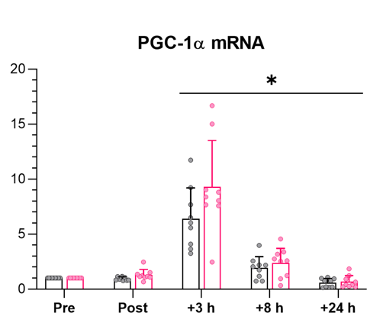
Human Performance Projects
Path to Impact
Project: Fuelling a fit Soldier
What we have learnt so far?
Lab Study 1 | Acute effects of “Recover Low”
Lab Study 2 | Training effects of “Recover Low”
8-week endurance training intervention
Whole-body: (VO_{2peak}, 20km TT, body composition)
Molecular: mitochondrial respiration, transcriptomics, mRNA content
2-min high-intensity intervals
completed to exhaustion
PGC-1α mRNA fold change
Field Study 1 | Energy demands in Navy recruits
Energy intake (Food diaries)
Total Daily EE:
3381 kcal/day
Resting Energy Exp. (Indirect calorimetry)
Resting EE:
1722 kcal/day
Total Daily EE. (Doubly-labelled water)
Diaz-Lara et al. (2022, in review)
Physical activity (Wrist-worn actigraphy)
What does that mean for ADF capabilities?
Important to replenish carbohydrates as soon as practically possible after high-intensity exercise
(often part of military training/ops.), particularly if:
recovery durations between training and/or operations are limited (i.e., < 24 h),
a maximal performance is required to complete subsequent sessions/tasks successfully
Analysis of food diaries ongoing
Implications will relate to what strategies can be implemented to ensure appropriate nutrition:
Timing
Types
Totals
Notes:
Lab Study 1 – restricting carbohydrate intake acutely after exercise (0-3h) does not enhance molecular responses associate with endurance adaptations, but impairs next day exercise capacity and increases perceptions of effort
Lab Study 2 (data collection ongoing) – exploring how 8-weeks of acute post-exercise carbohydrate restriction affects molecular and whole-body adaptations to endurance training
Field study 1 (analysis ongoing) – exploring energy intake/expenditure in Australian Navy recruits over 2-week training period.

Slide 3
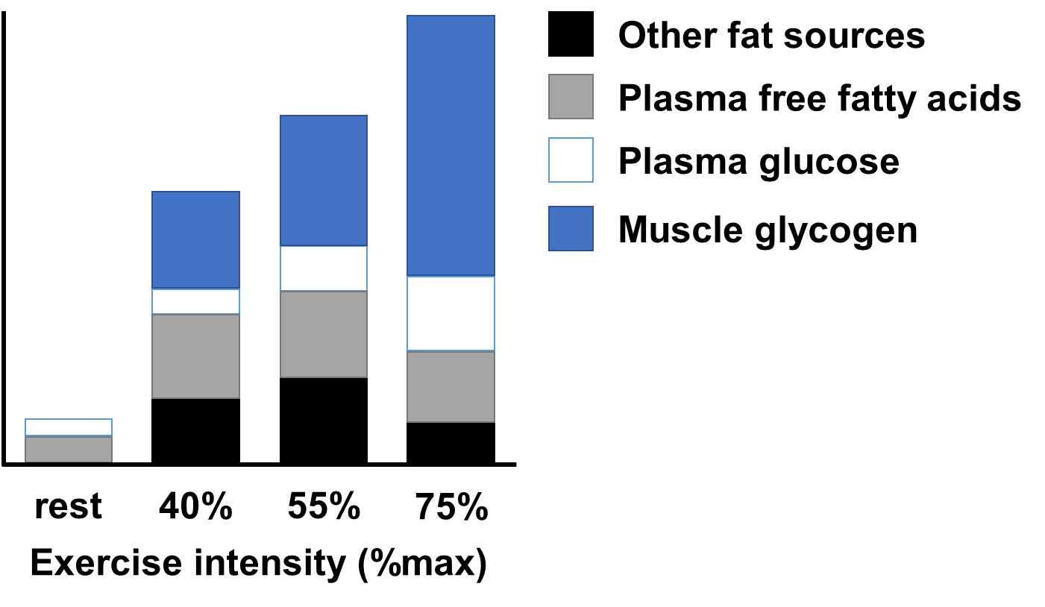
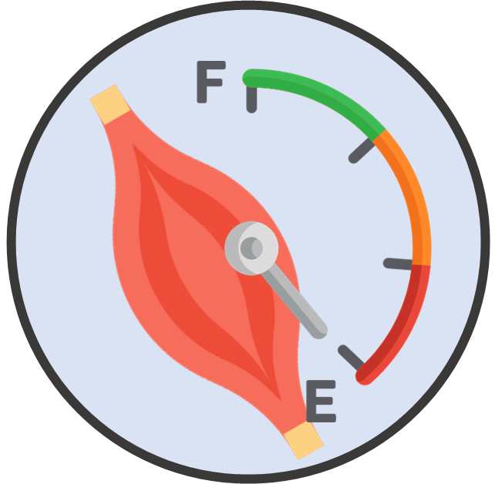
Human Performance Projects
The Science
Project: Fuelling a fit Soldier
Carbohydrates (i.e., glycogen) are the muscle’s preferred energy source to fuel high-intensity actions
Energy expenditure
van Loon et al. (2001) | J Phys, 536, 1:295-304
Soldiers consume suboptimal amounts of carbohydrate, compared to recommended sports nutrition guidelines and/or MRDIs
Beals et al. (2015) | Military Medicine, 180, 12:1239-1246
Baker et al. (2020) | J Acad Nutr Diet, 120, 10:1687-1705
Training with low muscle glycogen may:
Intensity and/or quality of session
 Compromise adaptations/
performance?
Amplify molecular signals that promote endurance adaptations
Pilegaard et al. 2005 | Metabolism, 54(8):1048-55; Yeo et al. 2008 | J Appl Physiol (1985), 289(6):E1023-1029
Cochran et al. 2010 | J Appl Physiol. 108(3):628–36; Bartlett et al. 2013 | Am J Phys Regul Integr Comp Physiol. 304 (6):450–8

