Slide 1
Human Performance Projects
Project Description
Project: Brain Stimulation
Main issues
Partners
The University of Queensland: Paul Dux, Jason Mattingley, Hannah Filmer,
Li-Ann Leow, Shane Ehrhardt, Yohan Wards
University of Oxford: Charlotte Stagg
DSTG: Nick Willmot
Purpose
Assess benefits of combined training and transcranial direct current stimulation (tDCS) at improving performance in military relevant tasks.
Examine longevity and transferability of combined training and tDCS.
Use neuroimaging to investigate the parameters that mediate and predict the effect of transcranial tDCS.
Identify optimal tDCS intensity for use with ADF personnel.
Product
Development and refinement of an optimal combined training and tDCS design for use with ADF personnel.
Detailed report on the utility of combined training and tDCS for improving cognition including individual mediating variables.
Notes:
So weve asked our uni leads to send through the issues theyre currently experiencing and what solutions they may be using to overcome their issues.
Noted issues are:
Any issues you are facing that isn’t covered here? Or any observations
Are there any risks/issues to the stakeholders that were missing? IE reputational risk. Minimising access to troops to reduce risk of further COVID outbreaks??
Short of postponing the project which risks losing PHDs and key researchers resulting in further delays in re-hiring, we need to look for new sustainable solutions.

Slide 2
Human Performance Projects
Path to Impact
Project: Brain Stimulation
Main issues
What we have learnt so far?
Completed large scale study (N = 178) showing evidence of combined tDCS and training leading to sustrained transfer of training benefits.
Have used MRI, and specifically magnetic resonance spectroscopy (MRS), to show that neurochemical concentrations in prefontal cortex predict the impact of training and stimulation.
What does that mean for ADF capabilities?
tDCS remains a viable cognitive intervention for ADF
Collectively our studies will be essential for informing ADF regarding the efficacy of tDCS.
Notes:
So weve asked our uni leads to send through the issues theyre currently experiencing and what solutions they may be using to overcome their issues.
Noted issues are:
Any issues you are facing that isn’t covered here? Or any observations
Are there any risks/issues to the stakeholders that were missing? IE reputational risk. Minimising access to troops to reduce risk of further COVID outbreaks??
Short of postponing the project which risks losing PHDs and key researchers resulting in further delays in re-hiring, we need to look for new sustainable solutions.

Slide 3
Human Performance Projects
The Science
Project: Brain Stimulation
Main issues
Pre-Training
4 Days of Training
Post-Training
N = 178
Notes:
So weve asked our uni leads to send through the issues theyre currently experiencing and what solutions they may be using to overcome their issues.
Noted issues are:
Any issues you are facing that isn’t covered here? Or any observations
Are there any risks/issues to the stakeholders that were missing? IE reputational risk. Minimising access to troops to reduce risk of further COVID outbreaks??
Short of postponing the project which risks losing PHDs and key researchers resulting in further delays in re-hiring, we need to look for new sustainable solutions.

Slide 4
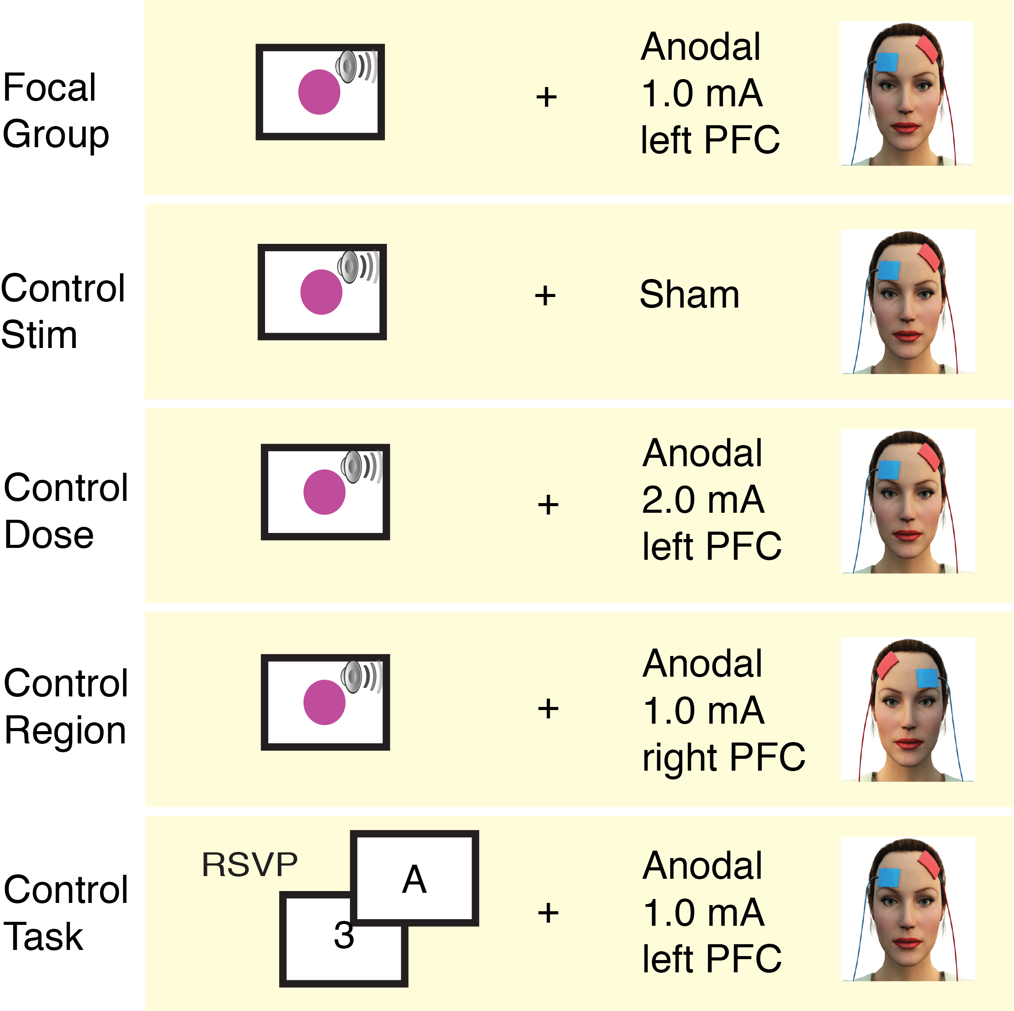
Human Performance Projects
The Science
Project: Brain Stimulation
Main issues
N = ~35 per group
Notes:
So weve asked our uni leads to send through the issues theyre currently experiencing and what solutions they may be using to overcome their issues.
Noted issues are:
Any issues you are facing that isn’t covered here? Or any observations
Are there any risks/issues to the stakeholders that were missing? IE reputational risk. Minimising access to troops to reduce risk of further COVID outbreaks??
Short of postponing the project which risks losing PHDs and key researchers resulting in further delays in re-hiring, we need to look for new sustainable solutions.

Slide 5
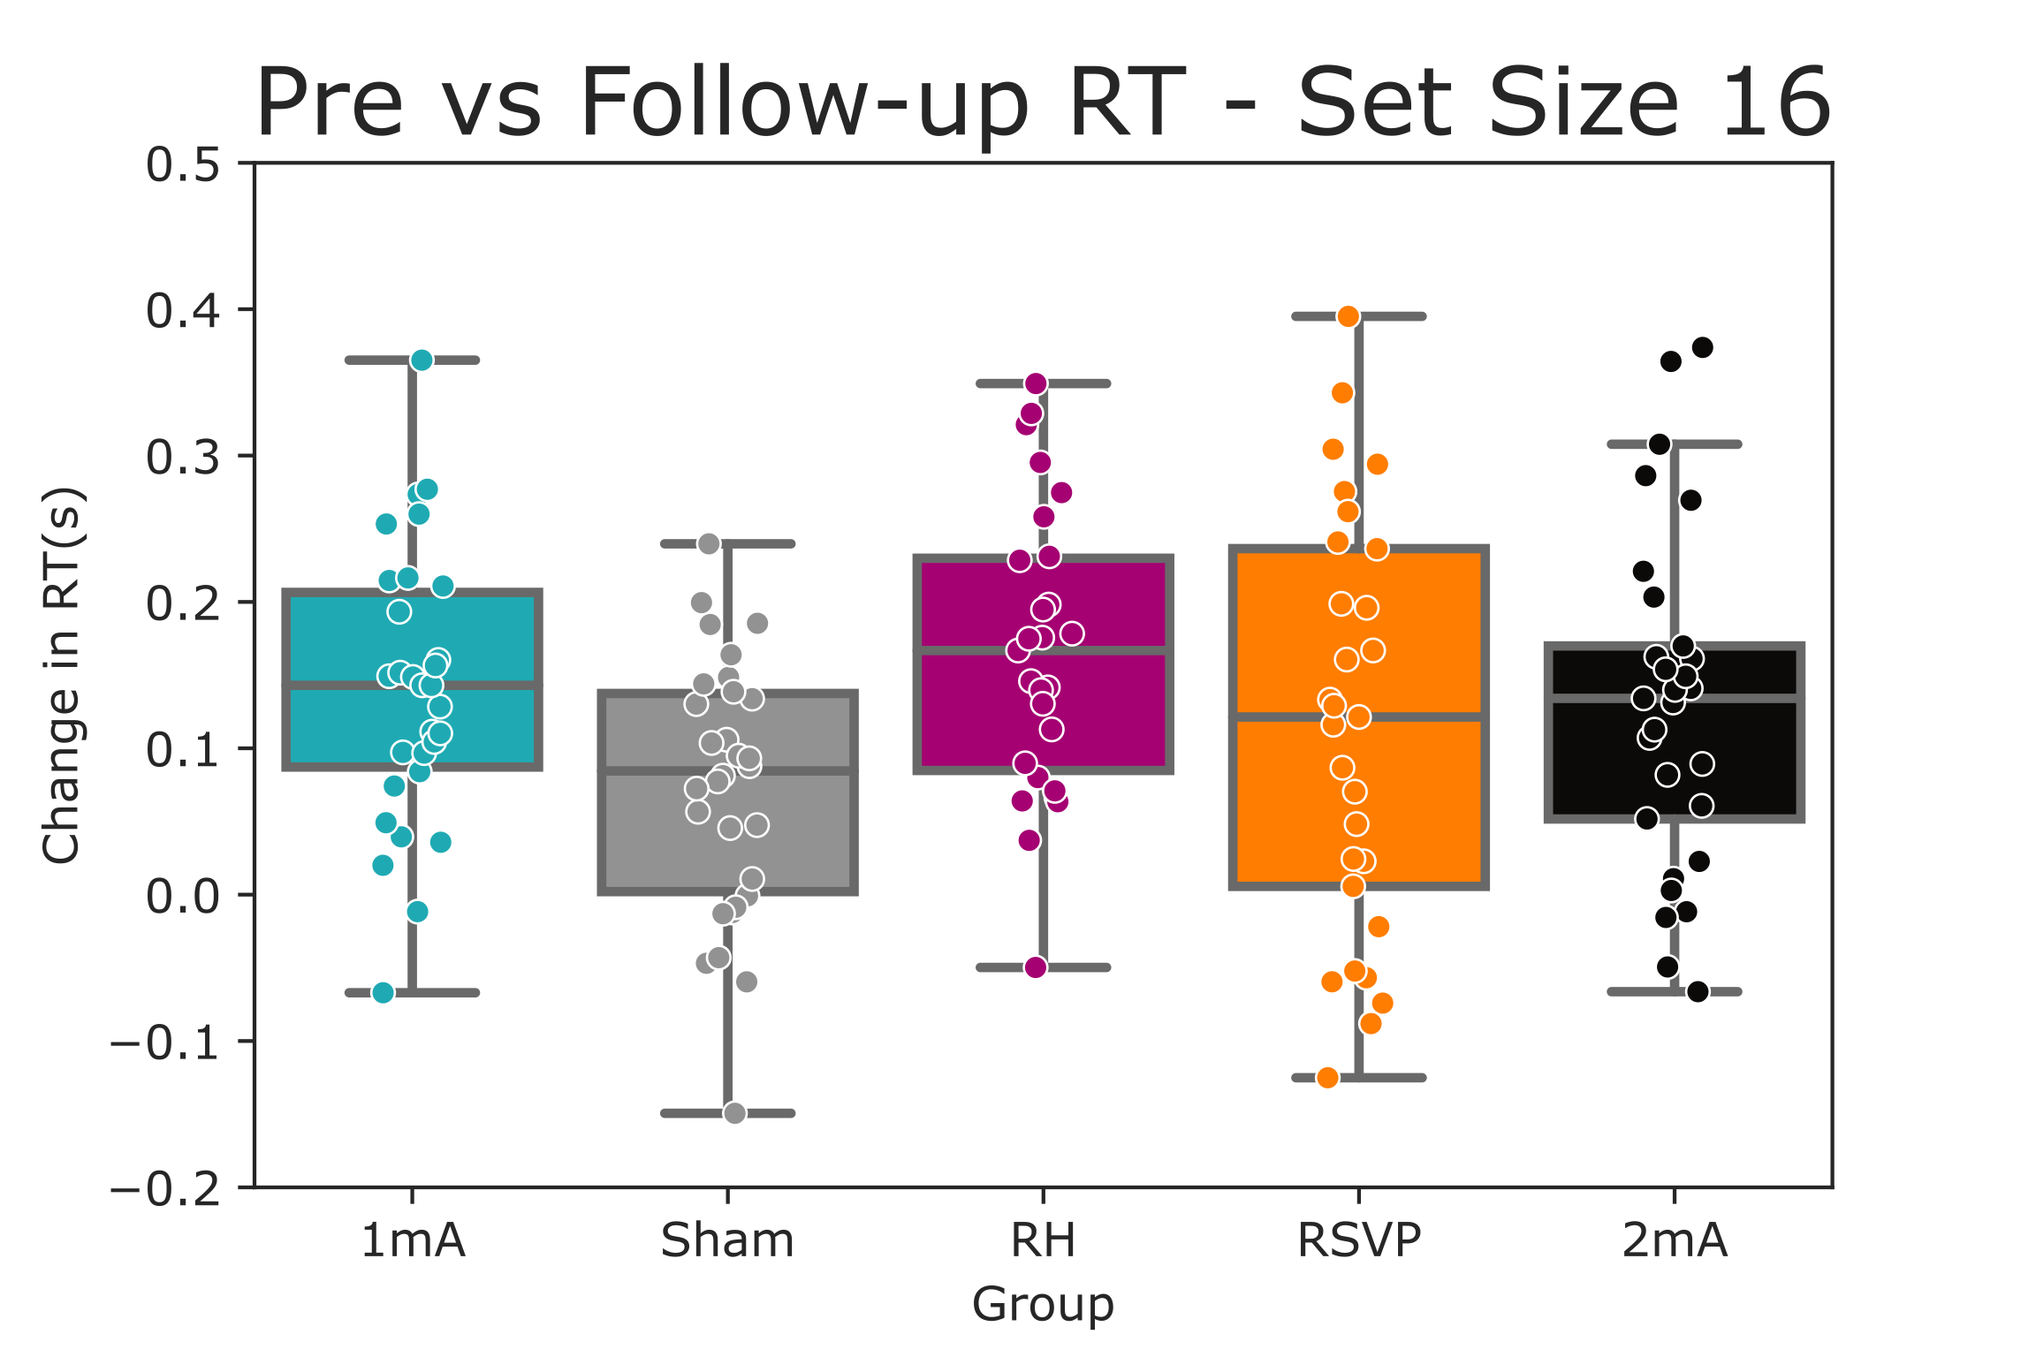
Human Performance Projects
The Science
Project: Brain Stimulation
Main issues
Notes:
So weve asked our uni leads to send through the issues theyre currently experiencing and what solutions they may be using to overcome their issues.
Noted issues are:
Any issues you are facing that isn’t covered here? Or any observations
Are there any risks/issues to the stakeholders that were missing? IE reputational risk. Minimising access to troops to reduce risk of further COVID outbreaks??
Short of postponing the project which risks losing PHDs and key researchers resulting in further delays in re-hiring, we need to look for new sustainable solutions.

Slide 6
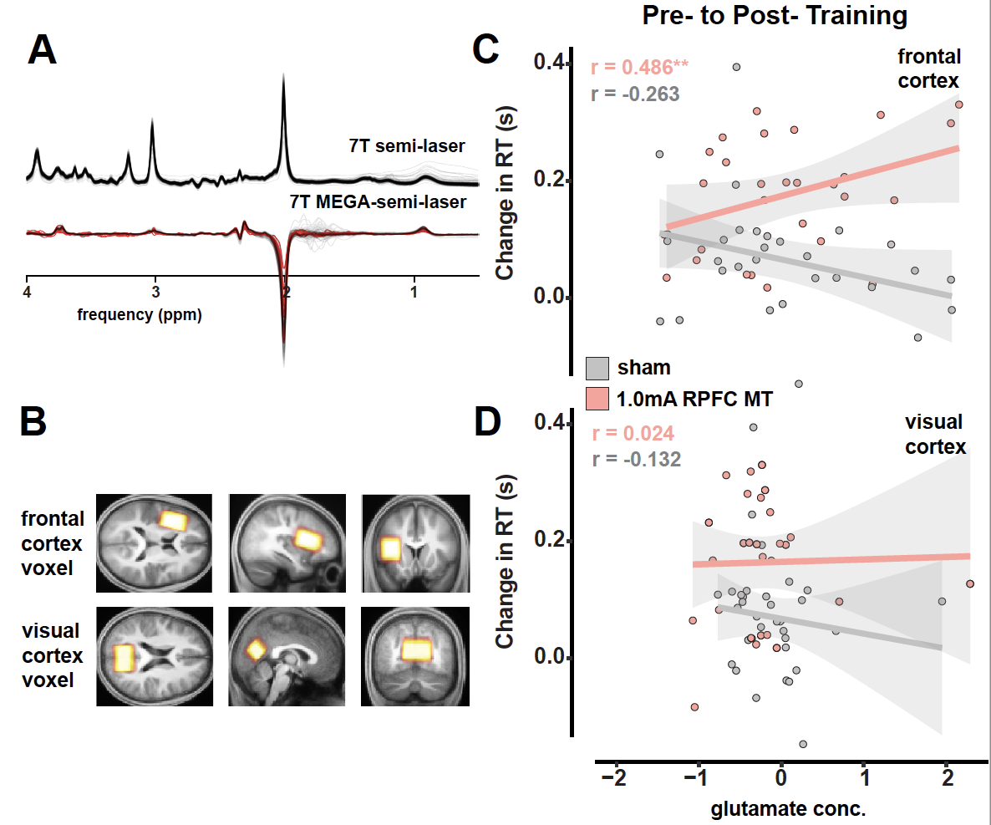
Human Performance Projects
The Science
Project: Brain Stimulation
Main issues
Notes:
So weve asked our uni leads to send through the issues theyre currently experiencing and what solutions they may be using to overcome their issues.
Noted issues are:
Any issues you are facing that isn’t covered here? Or any observations
Are there any risks/issues to the stakeholders that were missing? IE reputational risk. Minimising access to troops to reduce risk of further COVID outbreaks??
Short of postponing the project which risks losing PHDs and key researchers resulting in further delays in re-hiring, we need to look for new sustainable solutions.

