Slide 1
Human Performance Projects
Project Description
Project: Heat Resilience
Main issues
Partners
Uni of Western Australia: Dr Howard Carter, Prof Daniel Green
Uni of Adelaide: Prof Robert McLaughlin
Purpose
To understand the differences in response to heat+exercise of healthy subjects
Identify variables that predict heat resilience in Defence personnel.
Product
Identify physiological variables associated with the tolerability of heat stress.
Develop an assessment to identify Defence personnel at risk of heat injury.
Notes:
So weve asked our uni leads to send through the issues theyre currently experiencing and what solutions they may be using to overcome their issues.
Noted issues are:
Any issues you are facing that isn’t covered here? Or any observations
Are there any risks/issues to the stakeholders that were missing? IE reputational risk. Minimising access to troops to reduce risk of further COVID outbreaks??
Short of postponing the project which risks losing PHDs and key researchers resulting in further delays in re-hiring, we need to look for new sustainable solutions.

Slide 2
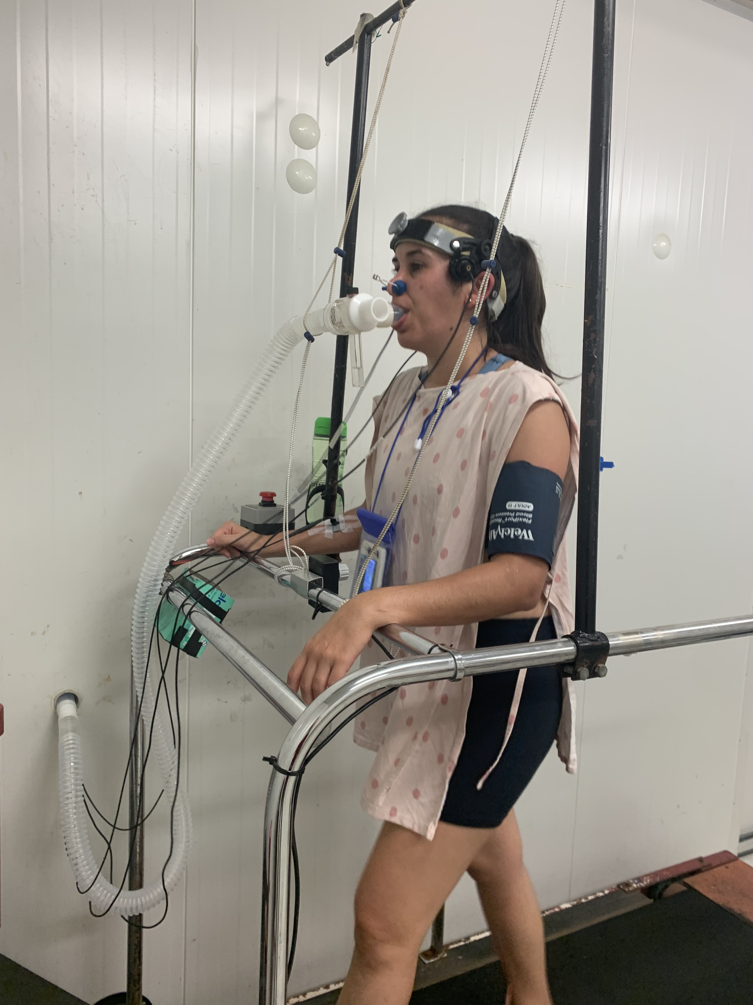
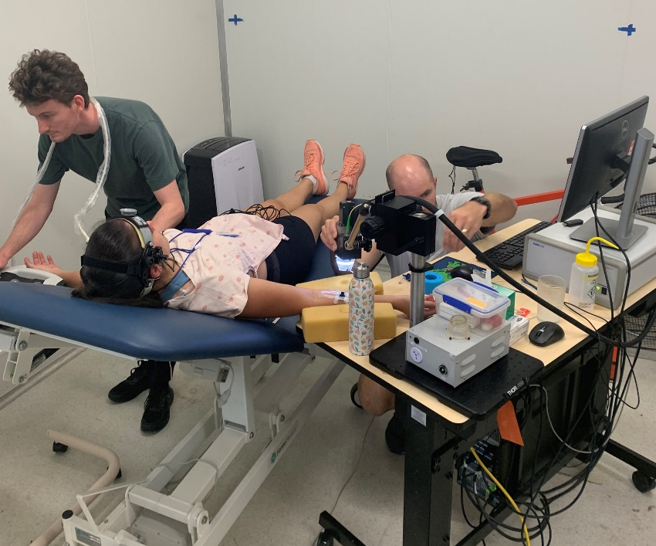
Human Performance Projects
Path to Impact
Project: Heat Resilience
Measures
Core body temperature, stroke volume, cerebral blood flow, heart rate
Optical imaging of skin microvasculature
Protocol
Climate chamber, 40ºC and 50% relative humidity
2hrs treadmill walk, 5 km/hr (2% incline)
Measurements at 0, 30, 60, 90, 120 mins
Subjects categorised as:
Completers (finished 120 mins)
Hyperthermics (core body temp ↑ 2ºC)
Symptomatics (unable to finish)
Notes:
So weve asked our uni leads to send through the issues theyre currently experiencing and what solutions they may be using to overcome their issues.
Noted issues are:
Any issues you are facing that isn’t covered here? Or any observations
Are there any risks/issues to the stakeholders that were missing? IE reputational risk. Minimising access to troops to reduce risk of further COVID outbreaks??
Short of postponing the project which risks losing PHDs and key researchers resulting in further delays in re-hiring, we need to look for new sustainable solutions.

Slide 3
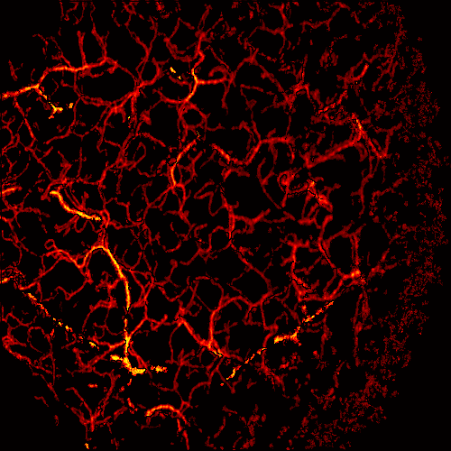
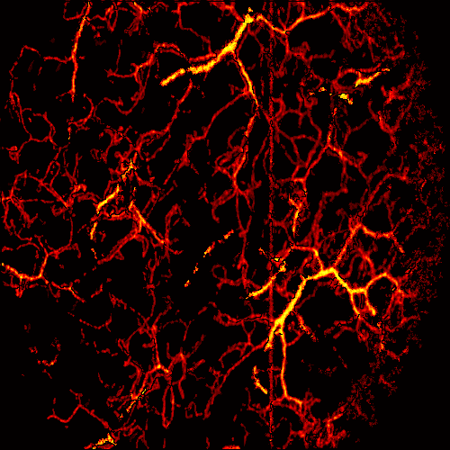
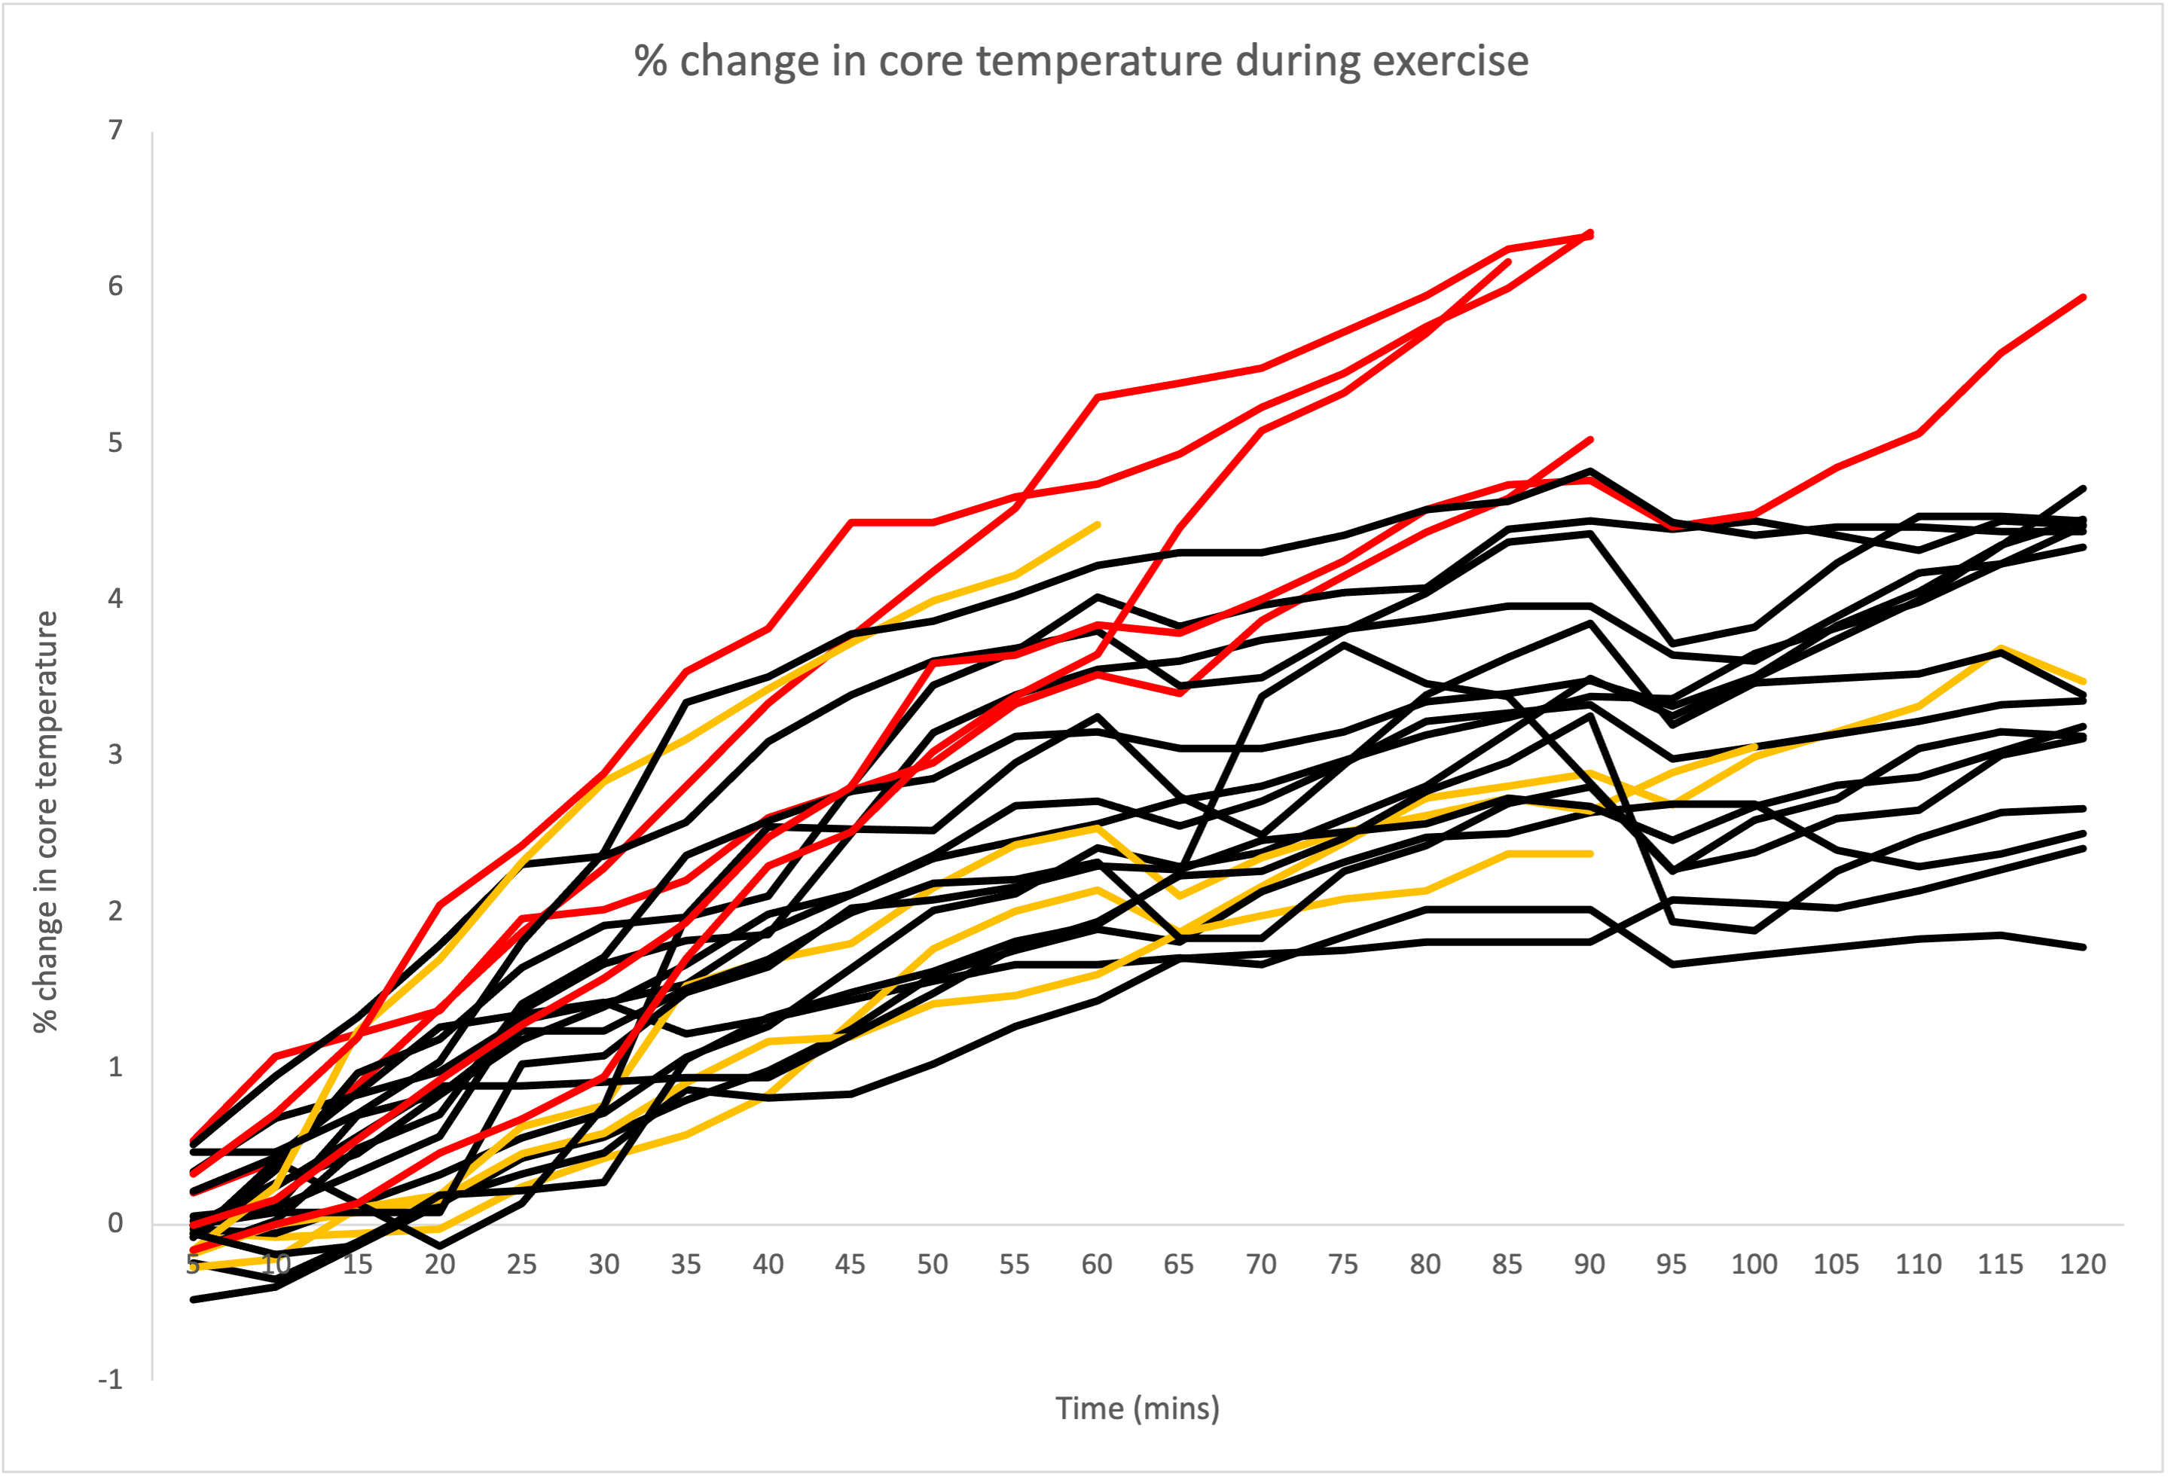
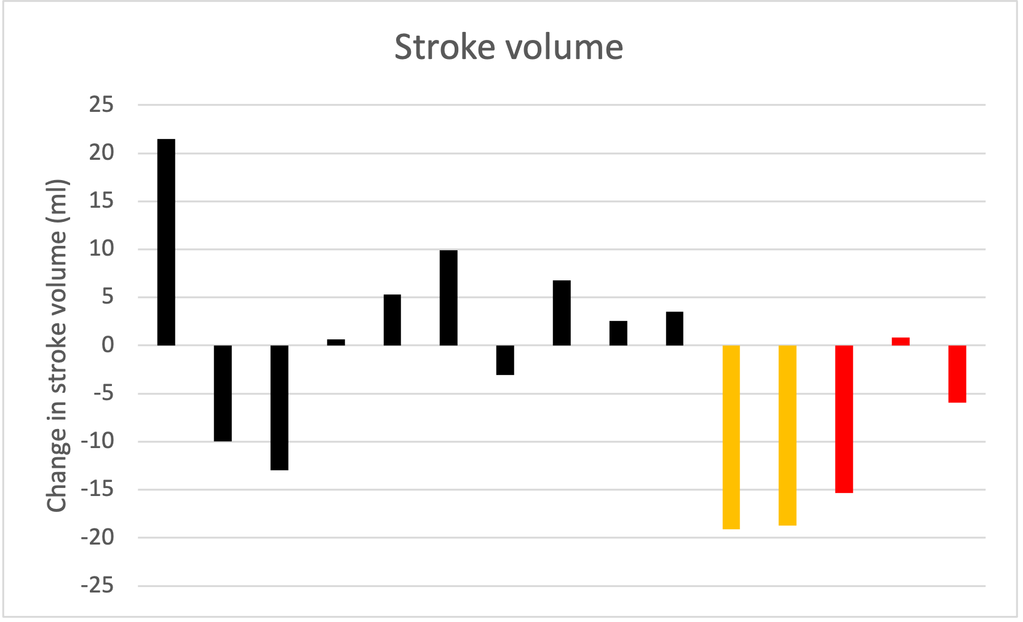
Human Performance Projects
The Science
Project: Heat Resilience
Main issues
Preliminary results
Skin blood flow increased with exercise
Core temperature of Hyperthermics did not plateau
Stroke volume tended to decrease in Symptomatics and Hypothermics
120 mins
Core temp vs time
Baseline
60 mins
Change in stroke volume (ml)
Hyperthermics
Completers
Symptomatics
1mm
Notes:
So weve asked our uni leads to send through the issues theyre currently experiencing and what solutions they may be using to overcome their issues.
Noted issues are:
Any issues you are facing that isn’t covered here? Or any observations
Are there any risks/issues to the stakeholders that were missing? IE reputational risk. Minimising access to troops to reduce risk of further COVID outbreaks??
Short of postponing the project which risks losing PHDs and key researchers resulting in further delays in re-hiring, we need to look for new sustainable solutions.

