Slide 1
Human Performance Projects
Project Description
Project: LEP effects of colour perception
Main issues
Partners
Dr Amanda Douglass, Prof Saeid Nahavandi, Prof James Armitage, A/Prof Larry Abel, Dr Renee Karas, Ms Kate Coffey, Dr Maria Gavrilescu
Purpose
Quantify the decrement in colour vision when using different LEPs
Examine the effect of LEP on task efficiency with current visual display colour schema
Investigate whether alternative colour schema can increase operational efficiency
Product
Evidence based recommendations for colour schema for use in future visual displays to be used with LEP
This work is supported by The Office of Naval Research Global (N62909-21-1-2002)
Notes:
So weve asked our uni leads to send through the issues theyre currently experiencing and what solutions they may be using to overcome their issues.
Noted issues are:
Any issues you are facing that isn’t covered here? Or any observations
Are there any risks/issues to the stakeholders that were missing? IE reputational risk. Minimising access to troops to reduce risk of further COVID outbreaks??
Short of postponing the project which risks losing PHDs and key researchers resulting in further delays in re-hiring, we need to look for new sustainable solutions.

Slide 2
Human Performance Projects
Path to Impact
Project: LEP effects of colour perception
Main issues
What we have learnt so far?
Identified in-service, research and commercially available LEPs
Computerised colour vision testing indicated LEP usage significantly reduces short wavelength (blue) sensitivity and increased longer (red/green) sensitivity, however each LEP creates a different effect on colour vision
Pilot testing demonstrates gaze pattern changes and likely accuracy changes depending on exact colour used for symbology and maps
What does that mean for ADF capabilities?
LEPs should be evaluated for colour changes before being introduced to service to allow adjustment of visual display colours for maximal efficiency
This work is supported by The Office of Naval Research Global (N62909-21-1-2002)
Notes:
Identified LEPs, note here we are only presenting the commercially available ones

Slide 3
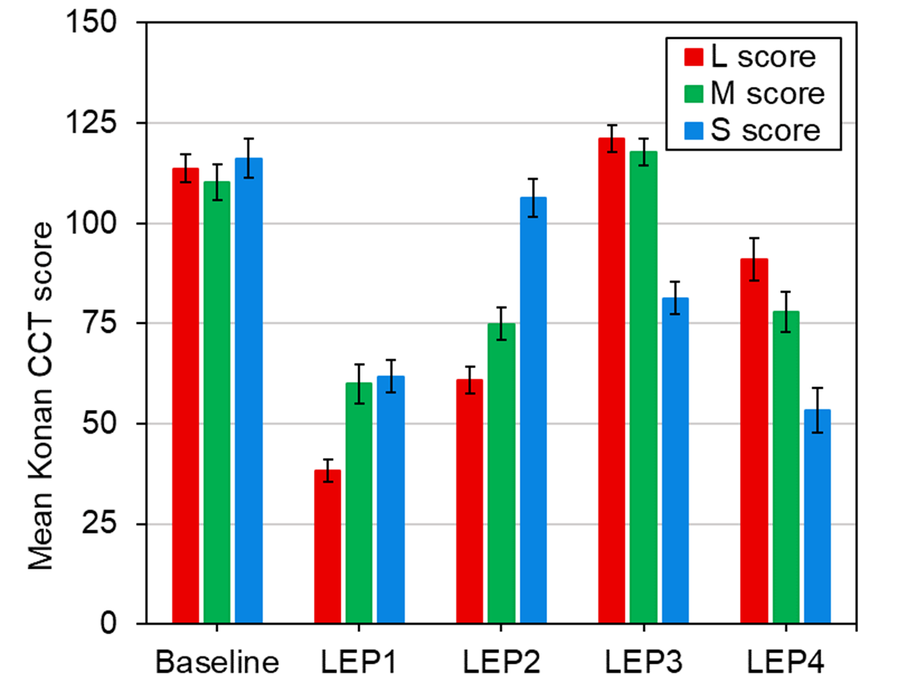
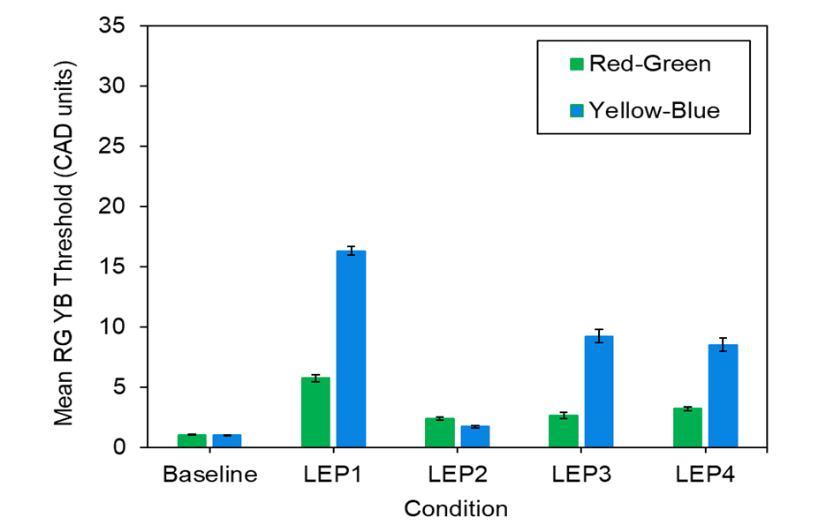
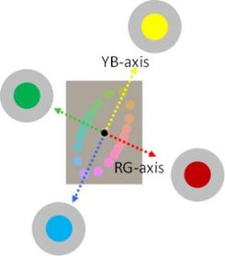
Human Performance Projects
The Science
Project: LEP effects of colour perception
Main issues
Colour normal observer
This work is supported by The Office of Naval Research Global (N62909-21-1-2002)
Notes:
So weve asked our uni leads to send through the issues theyre currently experiencing and what solutions they may be using to overcome their issues.
Noted issues are:
Any issues you are facing that isn’t covered here? Or any observations
Are there any risks/issues to the stakeholders that were missing? IE reputational risk. Minimising access to troops to reduce risk of further COVID outbreaks??
Short of postponing the project which risks losing PHDs and key researchers resulting in further delays in re-hiring, we need to look for new sustainable solutions.

Slide 4
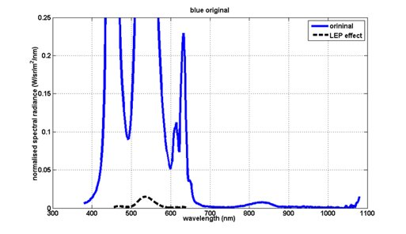
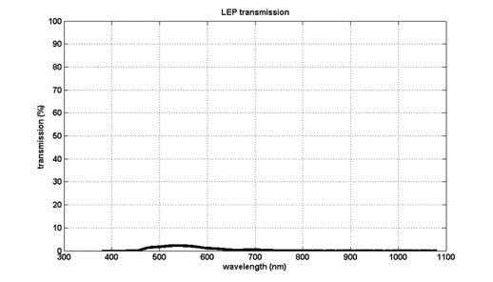
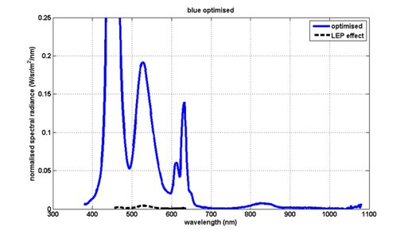
Human Performance Projects
The Science
Project: LEP effects of colour perception
Main issues
Colours have associated meaning and so ensuring the symbol is visible and still represents the intended colour is critical
Original appearance
This work is supported by The Office of Naval Research Global (N62909-21-1-2002)
Notes:
Colours have associated meaning and so ensuring the symbol is visible and still represents the intended colour is critical.​
The inducing effect of the extensive colour change in the background created by wearing the lep compensates for some of the blue filtering effects of the visor, which in the absence of the background would have made colours appear even more yellow. In this case the lighter blue (similar to blue prime) appears green through the LEP however the optimised blue shifts to a lighter/slightly greener blue but retains the blue perception

