Slide 1
Human Performance Projects
Project Description
Project: Wearable Assistive Technologies
Main issues
Principal Researchers and Project Partners
Victoria University (Prof Rezaul Begg, Prof David Bishop, A/Prof Daniel Lai)
The University of Melbourne (Prof Peter Lee)
DST Group (Dr Kurt Mudie)
Postdoctoral Fellow: Dr Alessandro Garofolini; PhDs: Mr Logan Hard, Ms Joselin George
Objectives
Identify and evaluate wearable assistive technologies for enhancing performance and minimising injury risk.
Evaluate commercial off-the-shelf (COTS) and custom load-sharing technologies.
Explore novel assistive technology concepts.
Quantify spinal load (Logan; PhD) and Predict user intention (Joselin; PhD).
Products
Increased capability in defence-related assistive technologies
An evidence-based framework for evaluating assistive technologies
Notes:
So weve asked our uni leads to send through the issues theyre currently experiencing and what solutions they may be using to overcome their issues.
Noted issues are:
Any issues you are facing that isn’t covered here? Or any observations
Are there any risks/issues to the stakeholders that were missing? IE reputational risk. Minimising access to troops to reduce risk of further COVID outbreaks??
Short of postponing the project which risks losing PHDs and key researchers resulting in further delays in re-hiring, we need to look for new sustainable solutions.

Slide 2
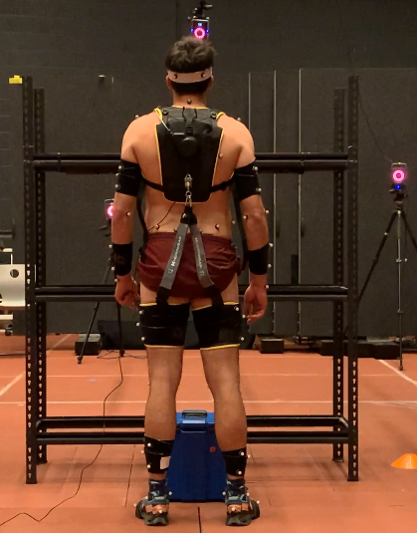
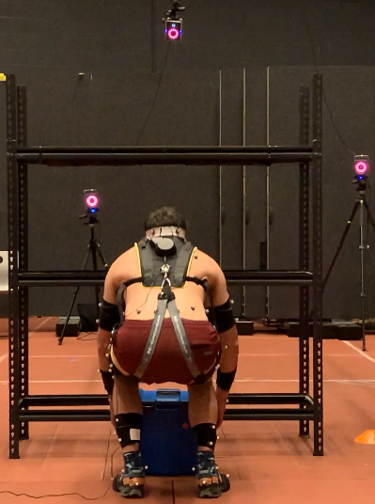
The Science
Lifting Assistance Project
Main issues
Lifting tasks with and without the exosuit:
Lift-carry-drop: 10 reps with one and two hands;
Lift-to-platform: 10 reps, two hands
Two ammunition boxes of 12.5kg and 25kg.
Full-body kinematics and kinetics recorded.
Herowear Apex exosuit
Performance variables: Cumulative Damage and Low Back Disorder (LBD) risk - calculated using LiFFT (Gallagher et al., 2017) and exo-LiFFT formulas (Zelik et al., 2022).
Notes:
So weve asked our uni leads to send through the issues theyre currently experiencing and what solutions they may be using to overcome their issues.
Noted issues are:
Any issues you are facing that isn’t covered here? Or any observations
Are there any risks/issues to the stakeholders that were missing? IE reputational risk. Minimising access to troops to reduce risk of further COVID outbreaks??
Short of postponing the project which risks losing PHDs and key researchers resulting in further delays in re-hiring, we need to look for new sustainable solutions.

Slide 3
Human Performance Projects
Path to Impact
Main issues
Human Performance Focus: Wearable Assistive Technologies
Major Findings to Date
Recordings from 120 lifts: exosuit reduced: (i) spinal load (- 34±6 Nm), (ii) cumulative damage (-74±8%), and (iii) low back injury risk (-27±5%).
Optimal supporting band stretching is related to user-device interaction and/or user motivation.
Beneficial effects for inexperienced personnel.
No adverse device effects on walking kinematics or kinetics.
A System Usability Score of 76 was obtained (>70 is acceptable).
Contribution to ADF capabilities
The Herowear Apex exosuit may reduce back injuries by 20-40% (e.g., a reduction of 2.5-5 LBDs per 100 employees averaging 12 LBDs per year).
Notes:
So weve asked our uni leads to send through the issues theyre currently experiencing and what solutions they may be using to overcome their issues.
Noted issues are:
Any issues you are facing that isn’t covered here? Or any observations
Are there any risks/issues to the stakeholders that were missing? IE reputational risk. Minimising access to troops to reduce risk of further COVID outbreaks??
Short of postponing the project which risks losing PHDs and key researchers resulting in further delays in re-hiring, we need to look for new sustainable solutions.

