Slide 1
Human Performance Projects
Project Description
Project: Team Cognobiome
Partners
Main issues
Purpose
Characterisation of cognitive performance, gut microbiome and physiological responses to high intensity, high stress situations
Targeted isolation of key microorganisms associated with improved cognitive performance
Use microbial isolates to characterise the mechanisms and host responses that influence cognitive performance
Product
Develop targeted inventions (pre- and probiotic) to improve cognitive performance
Notes:
So weve asked our uni leads to send through the issues theyre currently experiencing and what solutions they may be using to overcome their issues.
Noted issues are:
Any issues you are facing that isn’t covered here? Or any observations
Are there any risks/issues to the stakeholders that were missing? IE reputational risk. Minimising access to troops to reduce risk of further COVID outbreaks??
Short of postponing the project which risks losing PHDs and key researchers resulting in further delays in re-hiring, we need to look for new sustainable solutions.

Slide 2
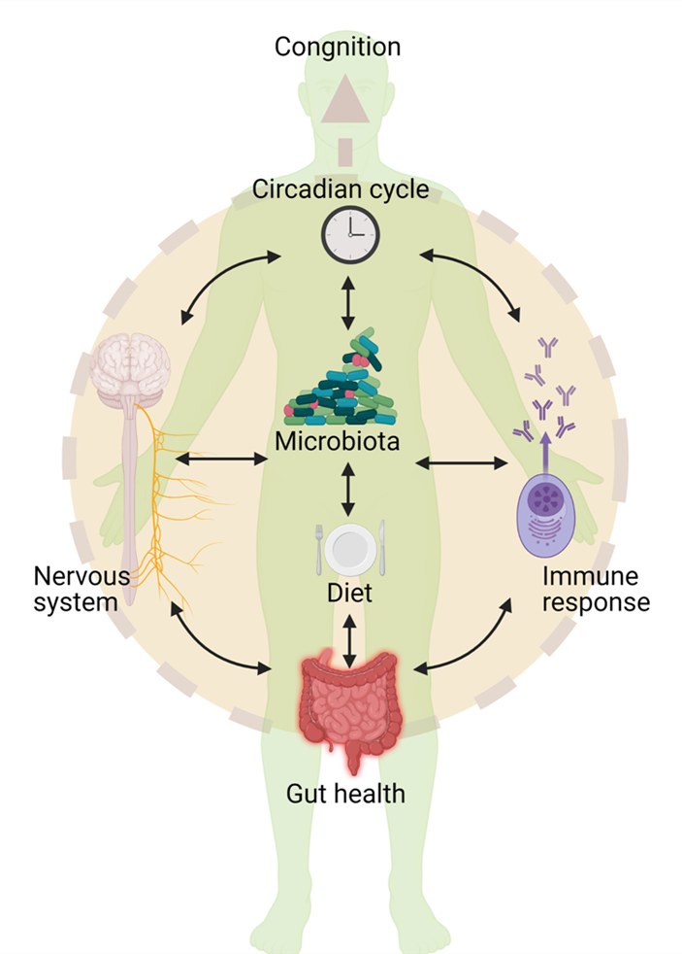
Human Performance Projects
Path to Impact
Project: Team Cognobiome
Main issues
What we have learnt so far?
Cognition is now recognised to be influenced by factors outside the CNS.
Cognitive impairment exists in numerous disease states, particularly diseases involving gut microbiome.
Available evidence suggests that gut microbiota is linked to cognitive performance.
Multiple pathways can link microbiome to cognitive function.
Limited studies to identify precise mechanisms and pathways. (Tooley, 2021)
What does that mean for ADF capabilities?
Identifying the pathways that would facilitate manipulation of gut microbiota to enhance cognitive performance.
Potential to develop “pill” based enhancer.
Notes:
So weve asked our uni leads to send through the issues theyre currently experiencing and what solutions they may be using to overcome their issues.
Noted issues are:
Any issues you are facing that isn’t covered here? Or any observations
Are there any risks/issues to the stakeholders that were missing? IE reputational risk. Minimising access to troops to reduce risk of further COVID outbreaks??
Short of postponing the project which risks losing PHDs and key researchers resulting in further delays in re-hiring, we need to look for new sustainable solutions.

Slide 3
Human Performance Projects
The Science
Project: Team Cognobiome
Main issues
Provisional approval
Biological Specimen Collection
Diet and Health Assessment
Cognitive Testing
Notes:
So weve asked our uni leads to send through the issues theyre currently experiencing and what solutions they may be using to overcome their issues.
Noted issues are:
Any issues you are facing that isn’t covered here? Or any observations
Are there any risks/issues to the stakeholders that were missing? IE reputational risk. Minimising access to troops to reduce risk of further COVID outbreaks??
Short of postponing the project which risks losing PHDs and key researchers resulting in further delays in re-hiring, we need to look for new sustainable solutions.

Slide 4
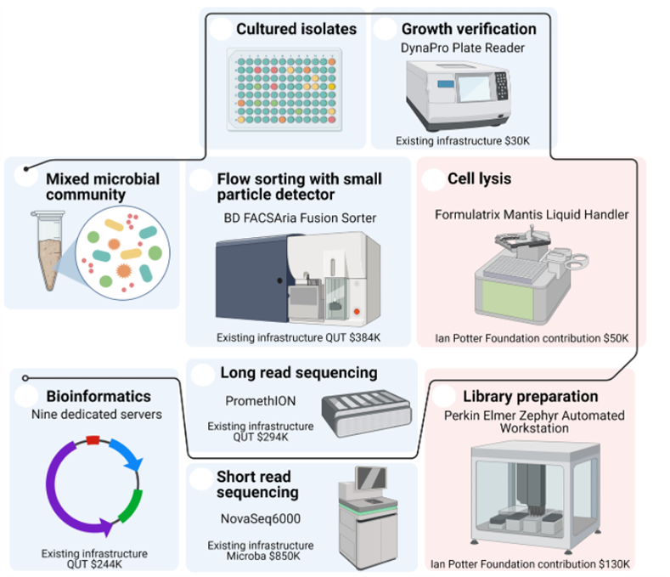
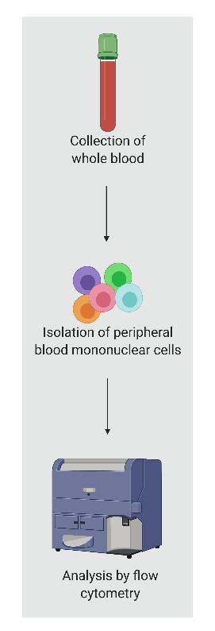
Human Performance Projects
The Science
Project: Team Cognobiome
Microbial Biobank
Immune phenotyping
Meta’omic microbiome
analysis
Diet and cognitive survey analysis

Slide 5
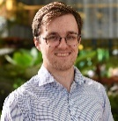
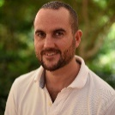
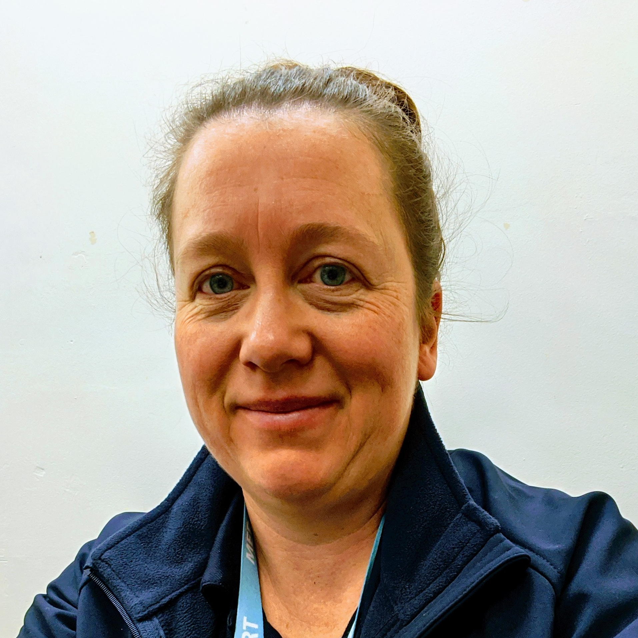
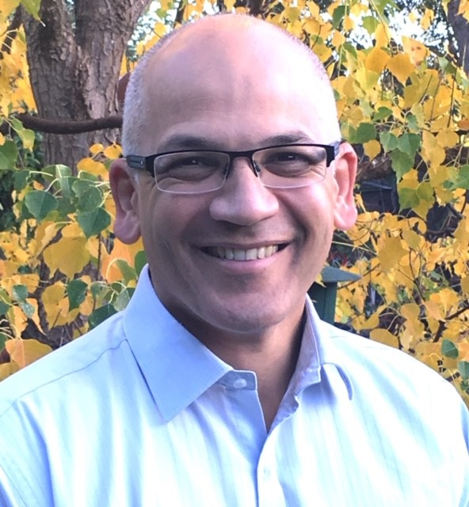
Acknowledgments
University of Newcastle
Laureate Professor
Nicholas Talley,
Gastroenterology
Professor Simon Keely,
Immunology and Microbiology
Dr Emily Hoedt,
Research Fellow
Microbiology
Dr Kerith Duncanson,
Research Fellow,
Dietetics
Associate Professor
Ami Eidels,
Psychology
Professor
Scott Brown,
Psychology
Dr Alexander Thorpe, Research Fellow
Psychology
Kirsten Swan
Project Manager
Sophie Fowler,
PhD Student
Laura Dowling,
PhD Student
Nicole Simm,
Phd Student
Queensland University of Technology
Professor Gene Tyson,
Bioinformatics
Associate Professor
Yi-Chin Toh,
Immunology
Associate Professor
Tony Kenna,
Immunology
Professor Ottmar Lipp,
Psychology
Professor Robert Speight,
Microbiology
Dr James Volmer,
Research Fellow, Microbiology
Dr Peter Sternes,
Research Fellow, Bioinformatics
Katherine Barlow,
PhD Student
Microba Life Sciences
Dr Paraic O Cuiv,
Microbiologist
Dr Lutz Krause,
Biostatistics
Dr Kylie Ellis,
Head of Research Partnerships
Swinburne University of Technology
DSTG
Associate Professor
Matthew Cooke,
Nutrition
Dr Katie Tooley
Senior Human Performance Scientist,
Cognition & Microbiome
Dr David Crone
Group Leader,
Cognition and Behaviour

