Slide 1
Towards a Proposed Defence CRC in Trusted Autonomous Systems
Research Information Sessions
26-28 Oct, 14 Nov 2016
Dr Jason Scholz, Dr Don Gossink, Dr Simon Ng, Dr Sylvie Perreau, Dr Robert Bolia, Dr Rob Hunjet, GPCAPT Andrew (Jake) Campbell, Dr Hugh Durrant-Whyte

Slide 2
Agenda
0930 Reception
1000 Background, Motivation, Aims, Overview – Jason Scholz
1030 Defence Requirements – ADF representative
1100 Current Research Projects – Theme Leaders
1200 Working Lunch
1230 Open Q&A / Discussion
1330 Request For Information (RFI) and Next Steps
1400 Close

Slide 3
Agenda
0930 Reception
1000 Background, Motivation, Aims, Overview – Jason Scholz
1030 Defence Requirements – ADF representative
1100 Current Research Projects – Theme Leaders
1200 Working Lunch
1230 Open Q&A / Discussion
1330 RFI and Next Steps
1400 Close

Slide 4

2016 Defence White Paper and Industry Policy Statement

Slide 5
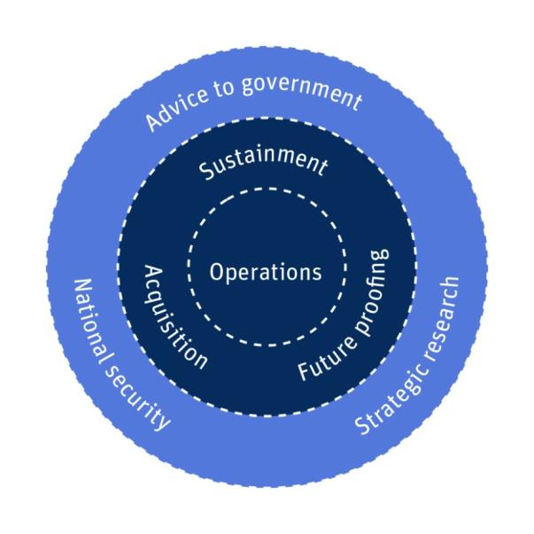
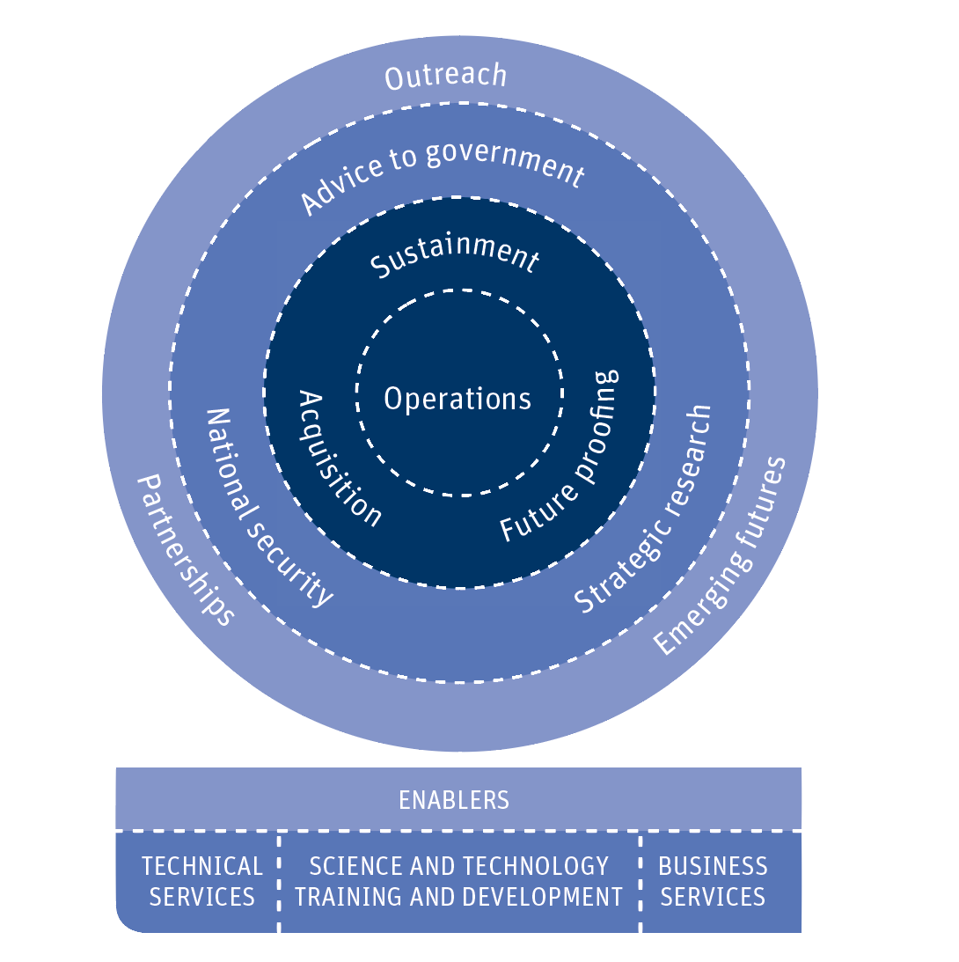
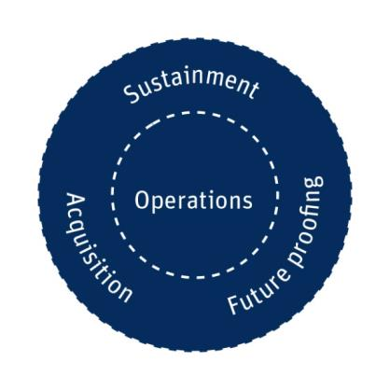
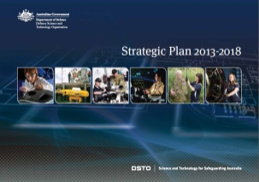
Defence Science and Technology
Purpose and Roles
UNCLASSIFIED
National leader in safeguarding Australia by delivering valued scientific advice and innovative technology solutions for Defence and national security
Notes:
DSTO Strategic Plan 2013-18
DST reduces risk in Defence’s core business – defence operations, intelligence, capability development and integration. It does this by providing specialist advice and innovative technology solutions that are grounded in research and are independent of commercial or non-Government research interests.
5

Slide 6
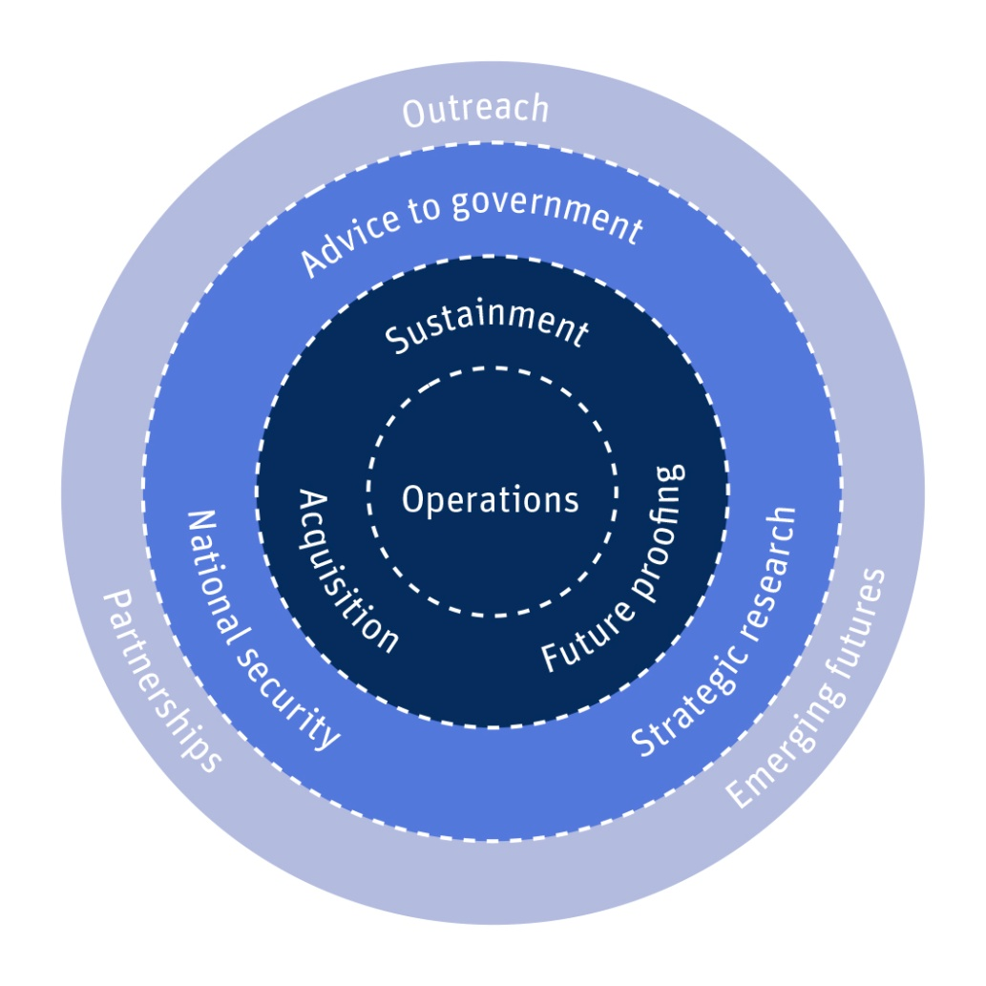

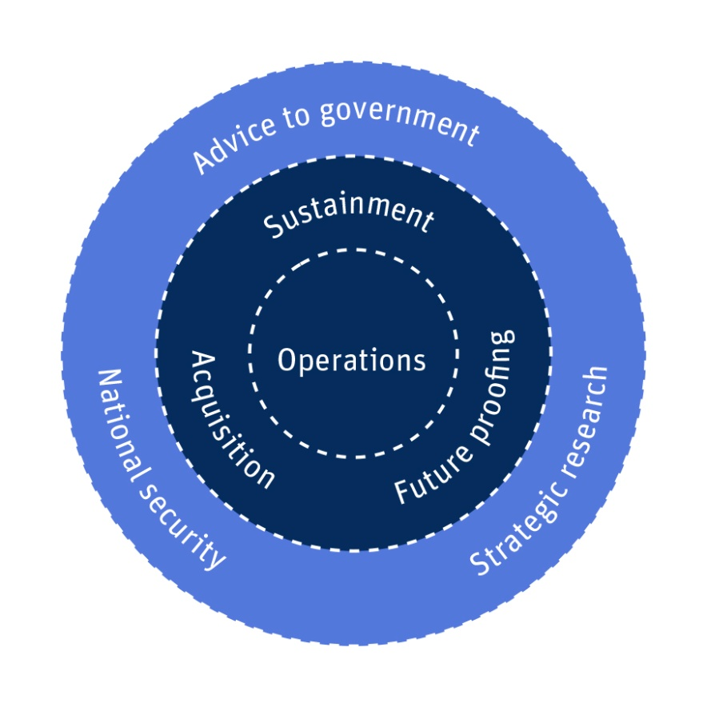
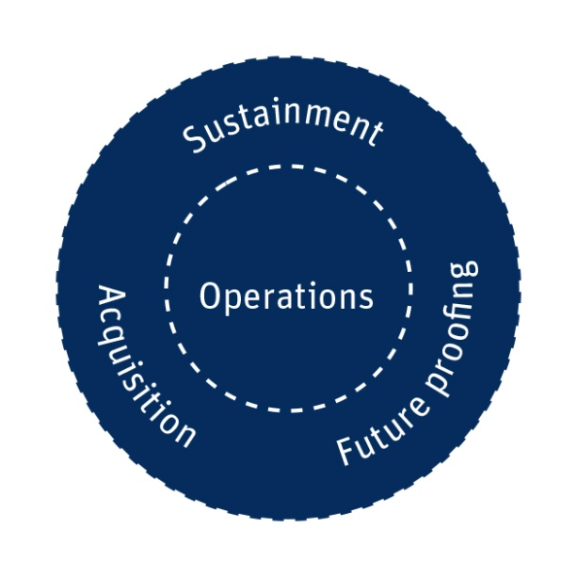


New Innovation Investments
The Hub
Defence
White Paper
Defence Industry Policy Statement
Defence Integrated Investment Plan
Next Generation Technology Fund
Notes:
DSTG core roles remain centred around providing expert and impartial advice and support for the conduct of operations, for the current force and for acquisition of future Defence capabilities.
These core roles are complemented by a greater emphasis on future Defence capability and a more outward-facing stance for DSTO.
This includes a stronger role in knowledge and innovation integration, which will be strengthened through partnerships, as well as a formal whole-of-government role in coordinating science and technology for national security.
6

Slide 7
Next Generation Technologies
“A Strategic Investment in S&T”
Technology driven Transformational Defence Domains:
  Cyber and Electronic Warfare
  Integrated ISR
  Space Capabilities
  Undersea Warfare
Game Changing Technology:
  Trusted Autonomous Systems
  Enhanced Human Performance and Resilience
  (Inc. Medical Countermeasures)
  Hypersonics technology
  Quantum Technologies
  Multidisciplinary Material Sciences

Slide 8
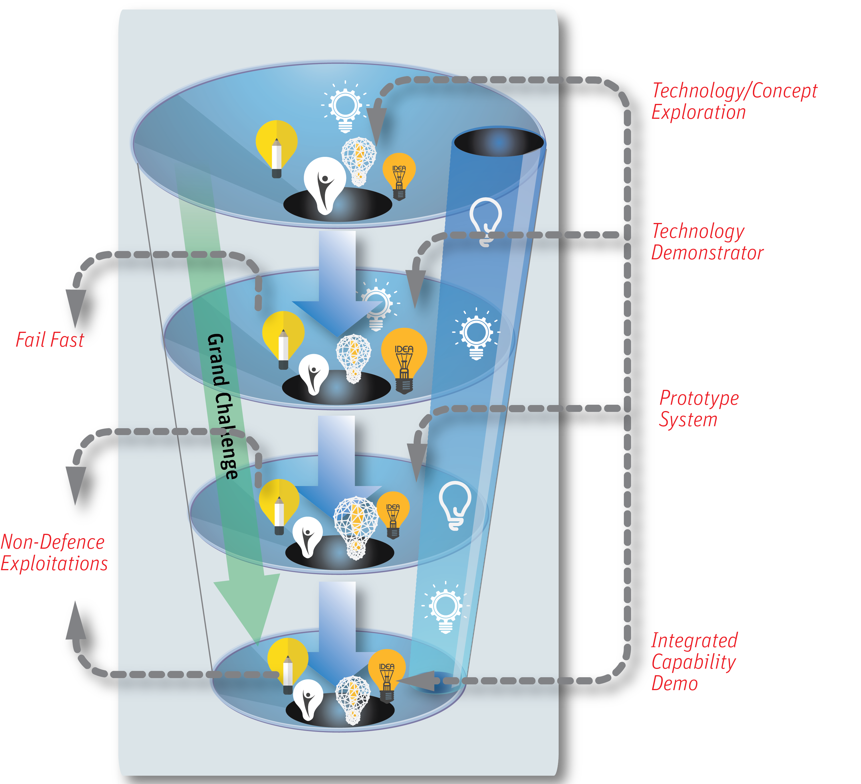
An Integrated Approach to Defence Innovation
UNCLASSIFIED
Next Generation Technologies
Defence
Cooperative
Research Centre’s
Defence Innovation Hub
Small Business
Exploratory Tasks
Strategic Research
Program
MURI
Grand Challenge
Defence Cooperative
Research Centre
Technology/Concept
Exploration
Technology
Demonstration
Prototype System
Integrated Capability
Demonstration
Defence-Industry
Collaboration
Innovative & Resilient
Capability Life Cycle
Notes:
The Next Generation Technologies Fund has been established to undertake research in these emerging technologies:
Integrated ISR
Space capabilities
Enhanced Human Performance
Medical Countermeasure Products
Multidisciplinary Material Sciences
Quantum Technologies
Trusted Autonomous Systems
Advanced Sensors, Hypersonics and Directed Energy
Supercomputing
Under the Next Generation Technologies Fund we expect to see proposals from industry and universities for new Cooperative Research Centres to be set up in the areas of emerging technologies.
8

Slide 9
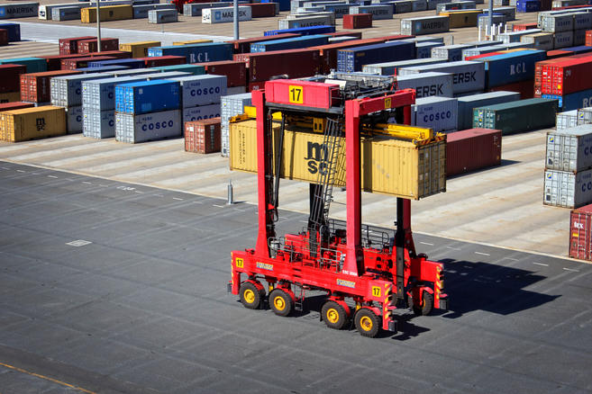
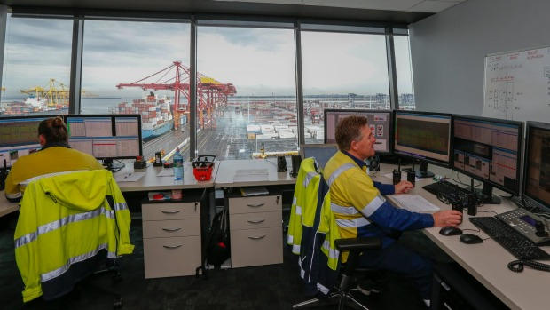
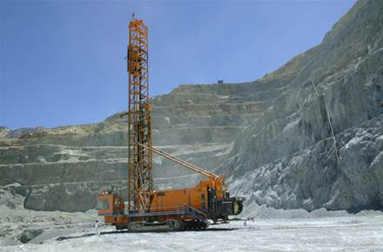

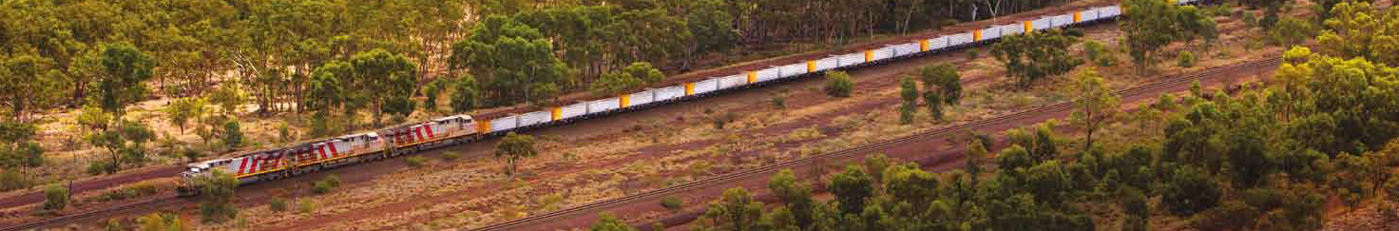
Trusted Autonomous Systems - Motivation
Patricks: “AutoStrads” developed by Australian Centre for Field Robotics (ACFR)
Rio Tinto: cabless drill, driverless trucks, driverless train (ACFR).
Logistics and Mining Operations
Australia a World leader in field robotics to improve operating efficiency and mitigate against Industrial Relations issues
Notes:
Australia is a leader in robotics applications to port operations and mining. Here are just a couple of examples.
As of April 2015, Patrick’s Port Botany container operations are now fully automated. This has changed the face of Industrial Relations in Australia.
Rio Tinto’s Mine of the Future vision has started to be realised with a range of automated systems now in operation.

Slide 10
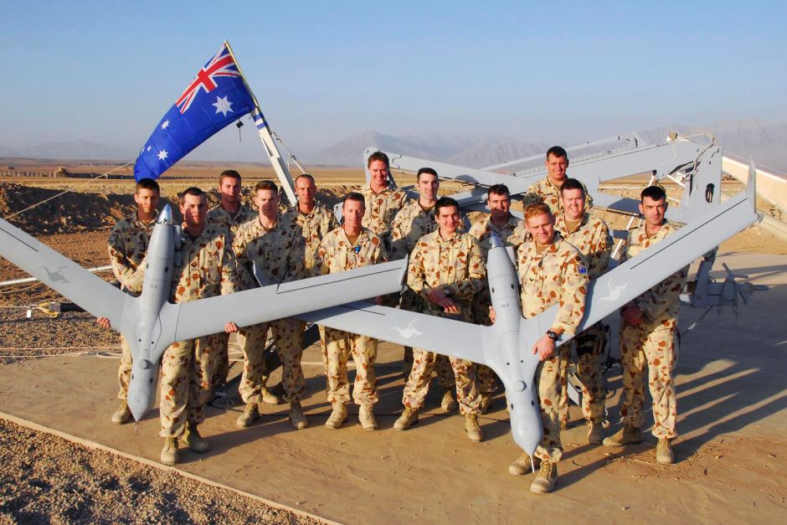
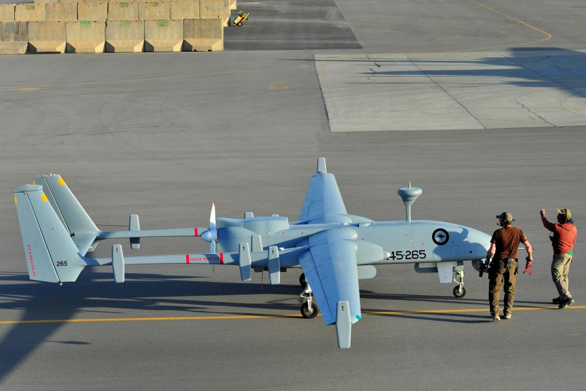
Motivation
RAAF Heron 2010-2012 AFN.
Since 2012 used for training prior to introduction of MQ-4C Triton
Scan Eagles 2007-2012 in Afghanistan flew 6,200 missions and 32,000hrs
Defence Operations
Australian Defence has also succeeded in leveraging robotics in operations.
However, Defence needs these systems the most in adversarial, contested, complex environments that can’t be easily managed, and where the consequences of failure can be high – for these operations the inventory is bare.

Slide 11
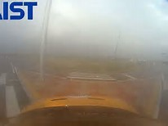
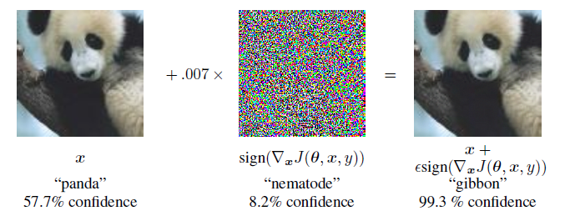
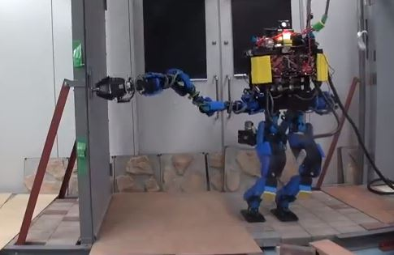
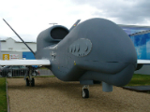
Example Problems
Automated decision and control systems with pre-programmed behaviours and efficiency goals often prove fragile when faced with the reality of unpredicted situations.
“Adversarial Examples” a vulnerability of ALL known forms of stochastic machine learning. http://arxiv.org/pdf/1412.6572v3.pdf
Perceptual Failure
Hyundai autonomous car competition called off after rain - Oct 14
Interactive Reasoning
DARPA Robotic Challengers
all fall down when comms is disrupted - Jun 2015.
Can’t easily adapt a solution.
Deutsche Euro Hawk cancelled deemed unverifiable without massive expense (2013)

Slide 12
Research Program
Autonomous systems have been promised for decades but they still haven’t arrived. Why? Is it because…
We can’t expect a different result if we do the same research!
New science and repurpose existing techniques
they aren’t resilient enough?
they aren’t smart enough?
people don’t trust them?
Persistent Autonomy
managing uncertainty and unpredictability,
persistent perception,
multi-modal fusion,
self-healing systems,
aggressive actuation.
Machine Cognition
machine learning,
artificial intelligence,
symbolic reasoning and logic,
theory of mind,
planning,
decision making,
social agents.
Human-Autonomy Integration
human-machine models,
behavioural and social models,
psychometrics,
shared decision making,
trust and uncertainty,
communications and narrative.

Slide 13
Functional Technology Program
Pull through and integrate outcomes from the fundamental research into three areas:
Perception and Sensing
resilient perception,
scene, situation and self-understanding,
modular low-cost intelligent sensors,
bio-inspired sensing.
Effectors and Platforms
self-managing platforms,
adaptable platforms and effectors,
bio-inspired platforms,
micro-systems, novel actuation,
low observability.
Intelligent Systems
multi-modal, multi-platform, data fusion,
multi-platform, multi-role decision making,
human-system integration.

Slide 14
Capability Demonstrator Program
Showcase integrated capabilities against Defence requirements
Demonstrate to Defence new ways to acquire autonomous systems capabilities
  Capability lifetimes radically more fleeting
  Autonomous systems potential for radically lower cost and larger scale
  Agile method philosophy supported by continuous integration environment
  Rapid system re-certification
Show Defence how fast these technologies may be adapted for deployable autonomous systems to create competitive advantage
Notes:
CRC-wide continuous software integration environment to speed technology transition, improve code sharing, without excess burden on researchers and developers
Uses high levels of automation in software development (auto-compiling, test harness, self-documenting code, etc…)

Slide 15
Research Strategy
Readiness Level
Machine
Cognition
Perception &
Sensing
ADF Offset
Capabilities
Capability
Demonstrator
Persistent
Autonomy
Effectors &
Platforms
International
Supply Chain
Human-
Autonomy
Intelligent
Systems
DCP Risk
Reduction
Science
Drivers
Capability
Requirements
Defence
Pull & Needs
Research Providers Industry Partners Defence Users

Slide 16
Agenda
0930 Reception
1000 Background, Motivation, Aims, Overview – Jason Scholz
1030 Defence Requirements – ADF representative
1100 Current Research Projects – Theme Leaders
1200 Working Lunch
1230 Open Q&A / Discussion
1330 RFI and Next Steps
1400 Close

Slide 17

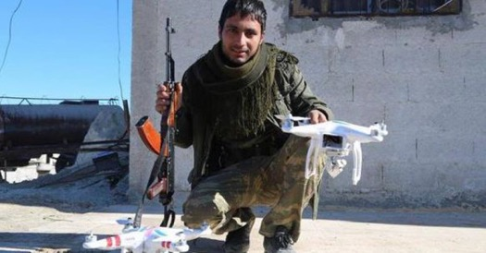
Why We Must Transform
A rapidly changing strategic environment means we must look for new and better ways of staying ahead of our adversaries.
Notes:
17

Slide 18
Subi and Fiery Cross Reefs

Slide 19
Global Commons
Australia is within reach

Slide 20

Emerging Business Cases
Example: Future Warfare - US Third Offset Strategy
Adversaries are developing their own ISR-strike networks—with emphasis on missile systems – to challenge conventional US power projection.
Close-in ports and airbases are vulnerable to attack,
Surface ships and aircraft carriers are easier to detect and track at range,
Non-stealthy aircraft are vulnerable to modern integrated area defence systems
Space is no longer a sanctuary

Slide 21
3rd Offset Operations (CSBA quotes)
Manned “combat endurance” - the portion of the mission spent inside enemy airspace – should also be considered very limited with even five hours “in the box” viewed as extreme.
In wartime, unmanned aircraft would provide a critical operational hedge against the loss of space both for ISR, precision navigation and timing (e.g.GPS ‘pseudo lites’) and long-haul communications (airborne communications relays).
To preserve the U.S. ability to reach into well-defended, close-in littoral waters, it will be likely necessary to field: A family of increasingly autonomous, difficult-to-detect, long range UUVs, which could be supported forward by manned SSNs… UUVs could help offset limited SSN/SSGN capacity by taking on a number of additional missions. UUVs hosted by a nuclear-powered submarine would, in effect, expand its geographic footprint and extend its reach into more hazardous shallow and constricted littoral waters.

Slide 22
Jericho Overview
Why Transform
Implementation Themes
Vision
Evolving Threats
Increased competition for global commons
Unprecedented ability to access data
Government needs rapid and agile military options
Introduction of 5th generation technology
Harness the combat potential of a fully integrated force
Future Air and Space CONOPs
Enhanced C2 through Decision Superiority
Train as we fight
Integrated simulation and experimentation
Agile
Adaptive
Information Age
Truly Joint
Develop an innovative and empowered workforce
Culture of innovation
Contemporary trade structures
System of systems thinking
Simplified horizontal and vertical organisational structures
Change the way we acquire and sustain capability
Acquisition times match technology
New ways to sustain capabilities
Attending to the enablers
Force by design
2015
Air Force Implementation Plans
2025
Notes:
So the RAAF needs to transform as a result of 5th generation technology and to counter evolving threats. We also need to ensure we can protect our national interests including access to the global commons. Australia’s sources 85% of its refined fuel from across Asia with a significant portion of that fuel passing thorugh the South China Sea. Freedom of navigation in that region is therefore fundamental to our national interest.
We also need to transform so that we can provide our tactical operators and operational commanders with the ability to access the huge volumes of data available – but in a measured way. At the same time, we need to be able to deny adversaries access to the information they need to do their job.
Op Okra – Australia’s contribution to the Air Campaign in Syria and Iraq – deployed and commenced operations in about a month. It was the first time the RAAF had deployed such a complex force independently and that has now set the baseline for rapid, high end response options for Government. We need to continue to evolve so that we can continue to provide that kind of response in the future.
As I mentioned, Plan Jericho will transform the RAAF by pursuing three Themes.
Firstly, Jericho aims to Harness the combat potential of a fully integrated force.
The primary focus of Jericho is on enhancing combat capability through integration of our force. Force integration is essential to superior decision making and the delivery of effects and therefore, the Jericho program is focussed on aspect.
Secondly, Jericho will develop an innovative and empowered workforce.
While the integration of the combat force is important to achieving competitive advantage over potential adversaries, to sustain that advantage over the long term demands an innovative and empowered workforce. Innovation is fundamental to a relatively small Air Force like the RAAF and so Plan Jericho is encouraging and developing organisational and individual behaviours that facilitate innovation. To that end, the new Air Warfare Centre is a critical first step in establishing the right thinking and behaviours.
Finally, Jericho intends to change the way we acquire and sustain capability.
Industrial age acquisition, transition and sustainment process are no longer sufficient to deal with the rate of change needed for information age capabilities. In order to leverage innovation, agile acquisition and sustainment processes and behaviours will be normalised. Working closely with Industry, new methodologies will be tested to try and reduce acquisition times by years.
The success of Jericho to this point stems from the way it was developed and is being implemented across the whole Air Force. The focus on combat capability makes it easy for airmen to buy into the program negating the need to ‘outsource’ our thinking and work effort. In addition, Navy and Army have been engaged with us and look to Jericho as a means to resolve some of there own integration issues (eg. Airborne gateway and CH-47 in Army)

Slide 23
TRANSIENT ADVANTAGE IS THE NEW NORMAL.
In the past, slow and steady updates gave us a sustainable capability advantage in a relatively predictable environment
shift
Now, we need to move fast to achieve transient advantages to stay ahead of our adversaries in a relatively unpredictable environment
We need to continuously identify and deliver against our next source of transient advantage to stay ahead of our adversaries
We now only have a transient advantage when our capability exceeds our adversaries
4
We could respond to our adversaries by using available platforms to maintain a sustainable capability advantage
Capability
3
2
shift
1
We can quickly lose this advantage as our adversaries catch up
1950 1980 2000 2010 2016 2018 2020 2022 2024 2026
Time
Legend
Our adversaries capability (aggregate)
how Air Force previously responded
how Air Force needs to respond into the future
Notes:
Not just technology focused
Workforce – new trades, adaptive people
Research and Development
Acquisition
23

Slide 24
Australian Defence Requirements for Autonomy
UNCLASSIFIED
Wide area ocean surveillance
Counter-insurgency Operations
Cyber-Electronic Warfare Operations
Urban & Littoral Operations
Humanitarian Assistance/Disaster Relief Operations
Requirements include:
Short Term | Medium Term | Long Term
Human-on-loop control | Teaming with manned platforms | Systemic integrity
Continuous, certifiable adaptation (improved smarts, mission type, payloads, etc) | Trustworthy for operators to use | Autonomous multi-mission / resource managed
High-fidelity object recognition | Area denied operation | High-fidelity situation and threat assessment
Space limited/denied operation | Alternate communications | Assured interoperability

Slide 25
Agenda
0930 Reception
1000 Background, Motivation, Aims, Overview – Jason Scholz
1030 Defence Requirements – ADF representative
1100 Current Research Projects – Theme Leaders
1200 Working Lunch
1230 Open Q&A / Discussion
1330 RFI and Next Steps
1400 Close

Slide 26
Current Projects
Human-Machine Integration
Human-autonomy team (HAT) effectiveness
Legal decisions for autonomy
High-level Autonomy
Human-autonomy team (HAT) learning
Non-stationary planning
Machine-Machine Interaction
Coordinated delivery of effects
Evolution of swarm behaviours
Embodied Autonomy
Long range navigation for UAVs
multi-modal autonomous systems for urban ops
Socialised autonomy
Mobile robot control interaction
Decentralised flow control
Autonomous goal and resource management
Survivable ad-hoc unmanned vehicle networks
Adaptive Flight

Slide 27
Human Machine Integration
More autonomous systems in the battlespace
Why the human element needs to be considered?
Intelligent machines seamlessly integrated with humans – Maximising mission performance in complex and contested environments (AFRL Autonomy S&T Strategy)
Notes:
Introducing more autonomous systems into the battlespace does not mean that we are simply getting rid of the human. These systems will always be supervised at some level. Further, existing autonomous systems are brittle - they rely on human intervention to cope with unplanned dynamic events. We are investigating ways to enhance the teaming of human operators and autonomous systems to deliver robust and adaptive mission performance.

Slide 28
Human Autonomy Teaming (Effectiveness and interaction)
Background: Current generation autonomous systems each require the support of one to many humans.
Goal: Examine how to achieve adaptive supervisory control of multiple unmanned assets. Understand the fundamental underpinnings of Human Autonomy Teaming (HAT), its enhancement, and how it is tested in dynamic uncertain environments.
Research Agreements: UWA (Autonomy Transparency), WSU (Trust in Human Machine Interaction)
Industry: AOS & Insitu Pacific (Intelligent Watch Dog), AOS & Northrup Grumman (Intelligent Battlespace Advisor)
Other Partners: TTCP Autonomy Strategic Challenge, MCMACE Project Agreement (4 eyes).
POC: Dr Michael Skinner

Slide 29
Legal Decisions for Autonomy
Background: Increased use of autonomous systems will likely increase the workload for deployed legal officers, yet the nature of legal decision making in operations has not been much studied from a psychological or cognitive perspective.
Goal: To identify information and decision processes which would benefit from machine support to reliably meet national expectations of legal compliance and ethical behaviour (particularly in relation to the use of autonomous systems). Then to develop and provide that support as more autonomous systems are introduced.
Research Agreements: Macquarie Uni (Legal/ethical decision making with autonomous systems)
POC: Mr Piers Duncan

Slide 30
Socialised Autonomy
Background: The impact of autonomous systems on social systems is unknown. How will headquarters command and control manage authority, accountability/responsibility, and competency when both commanded force elements and HQ itself consist of human-machine teams?
Goal: Investigates how human and autonomous systems can leverage each other’s strengths and compensate each other’s weaknesses to manage uncertainty while improving coherence and performance of the overall socio-technical system, with a focus on operational level military headquarters (HQ).
Research Agreements: ANU (Human Autonomy Teams in Military HQ)
POC: Dr Sharon Boswell

Slide 31
Mobile Robot Interaction
Background: There is nascent game-changing potential for autonomous systems in land combat personnel protection (close combat). E.g. Would a section able to orchestrate autonomous sensors, effectors and mobile armour to protect themselves, have an advantage over six soldiers walking in on their own?
Goal: Research bi-directional low-cognitive-load interaction between mobile robots and their human operators under stress (e.g. via hand-gesture, voice command; and the ability for robots to seek and accept new instructions from human operators, and query them if necessary.)
Research Agreements: TBA
POC: Dr Michael Ling

Slide 32
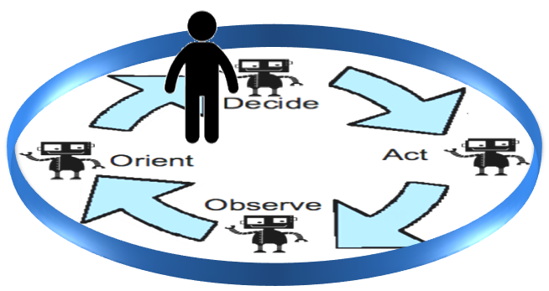
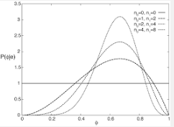
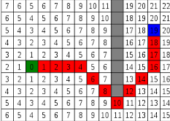
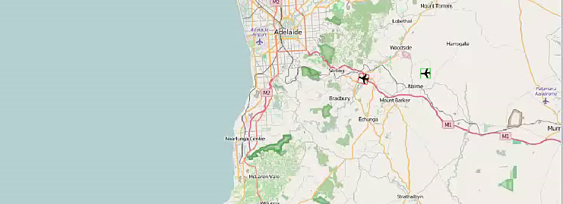
Human-Autonomy Teaming (HAT)
Project Lead: Dr Glennn Moy
Goal: Develop advanced Recommender systems to aid in the Command and Control (C2) of multiple autonomous vehicles.
  From “Human in the loop” to “Human on the loop”
S&T / Research Areas:
  Developing Recommender Systems Techniques:
    Reinforcement Learning (Deep Q Learning)
    Bayesian Techniques
    Data Classifiers (Supervised/Unsupervised learning)
    Classical Planning (Iterative Width Planning)
    “Play-Based” Heuristics
  Combining Techniques:
    Developing approaches for combining, prioritising and explaining recommendations from multiple agents.
Notes:
Develop advanced recommender system (machine learning) techniques to aid in the Command and Control (C2) of multiple autonomous vehicles, in order to reduce the cognitive burden on military operators. Combine prioritising and explaining recommendations from multiple agents, as well as developing the techniques that these agents themselves implement.

Slide 33
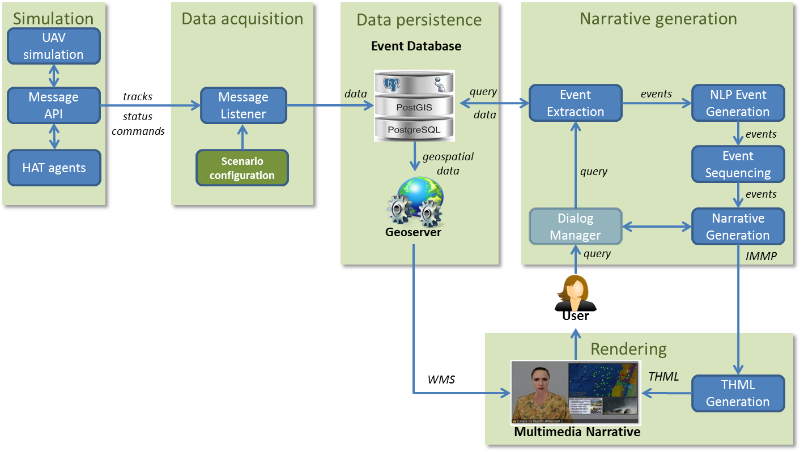
Multimedia Narrative
Project Lead: Dr Steven Wark
Goal: Trusted interaction with autonomous systems for human supervisors ‘on-the-loop’ to provide situation awareness and explanation of reasoning that establishes context and ‘situates’ the supervisor.
S&T / Research Areas:
  Intelligent Multimedia Presentation / Narrative Visualisation
  Rhetorical Structure Theory
  Pattern Recognition
  Multimedia Summarisation
  Automated Narrative Generation
  Narrative Dialogue Management
  Trust Management
  Machine Learning / LSTM

Slide 34
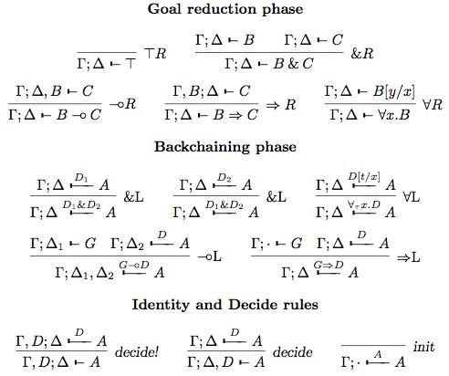
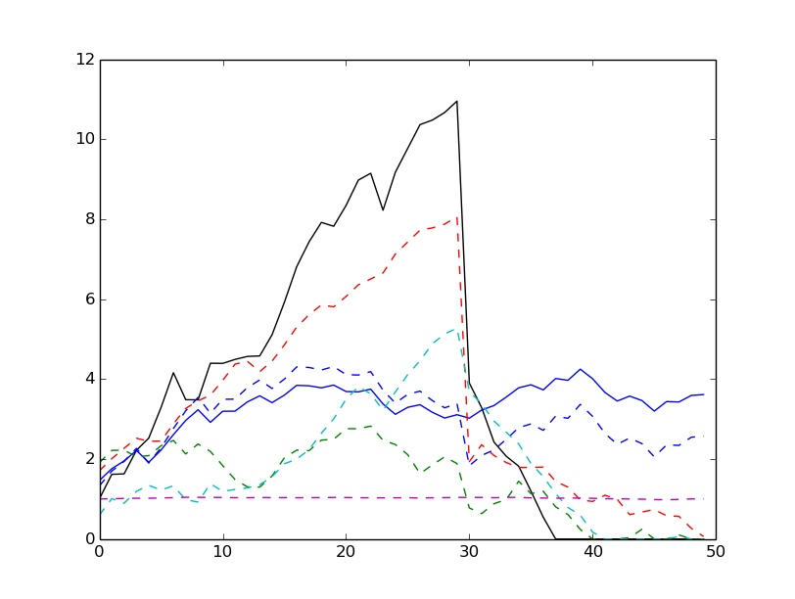
Nonstationary Planning
Project Lead: Dr Darryn Reid, Principal Scientist
Goal: Develop logic-based planning and reasoning capable of operating under fundamental uncertainty (including state-space ignorance) in complex dynamical environments
S&T / Research Areas:
  Economics (resource allocation with hard resource constraints) under uncertainty; bimodal strategy;
  Positive goals together with avoidance of exposure to plan-complete failure states
  New families of multi-modal logics to handle fundamental uncertainty
  Logical theory of self to determine exposures
  Online, any-time dynamic planning search
  algorithms for multiple logics
  Formal axiomatic systems hierarchy
Notes:
Autonomous systems need to be able to deal more successfully with fundamental uncertainty (non-ergodic). This is about planning that avoids catastrophic failure yet still can exploit opportunities when presented, in non ergodic non stationary environments. There is also an element of a refutation approach to verification and validation of autonomy.
Some of the S&T areas are:
Nonlinear Dynamics,
Economics – Bimodal Strategies
Theory of Self and Mind
Epistemic and Deontic logic, and
Hierarchies of formal reasoning.

Slide 35
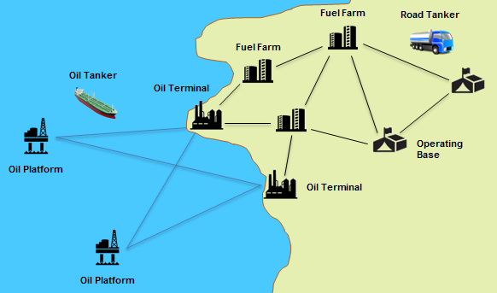
Decentralised Flow Control
Project Lead: Slava Shekh
Goal: To develop novel algorithms for decentralised control of network-based distribution activities in dynamic and uncertain and contested Defence logistics environments.
S&T / Research Areas:
  Markov decision processes
  Mixed-integer programming
  Monte Carlo tree search
  Heuristic techniques
  Multi-scenario planning
  Classical planning
  Agent Based approaches
Notes:
Autonomous systems may be a game changer for logistics, however, many current systems are designed to optimise for efficiency with centralised control, which is vulnerable to disruptions.
This activity is focused on the what would be the next challenge of Autonomy once baseline vehicle autonomy is achieved; how would it change logistics from a chain to a network and the monitoring and control of flow in that network in the presence of failures of routes/platforms/warehouses and surges in consumables

Slide 36
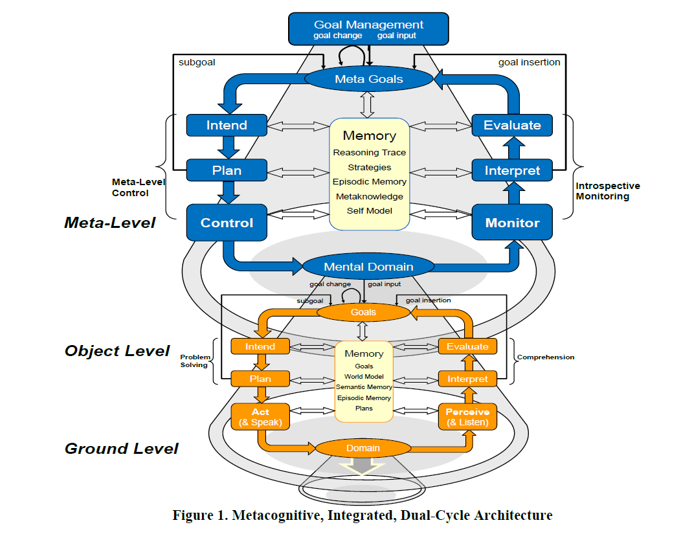
Autonomous Goal and Resource Management
Project Lead: Dr. Martin Oxenham
Goal: To develop autonomous agents which are capable of (i) recognising when the world in which they are operating diverges from what is expected, (ii) distinguishing between competing hypotheses that explain these changes of circumstance and (iii) formulating and managing goals to pursue in response to them.
S&T / Research Areas:
  Goal-Directed Autonomy (GDA)
    Eg. MIDCA – Metacognitive Integrated Dual-Cycle Architecture
  Machine Cognition incorporating
    Anomaly Detection
    Logical and Probabilistic Inference
    Data and Information Fusion
    Machine Learning
    Automated Planning
Illustrative Graphics
MIDCA
Notes:
Deep autonomy requires the ability to be self-directing for extended duration missions.
This activity seeks to develop theories that endow autonomous platforms with the means to be self-directing and manage competing intentions in an agile goal-driven fashion within platform and mission constraints.
Jointly investigating GDA as a means of incorporating executive control into next generation autonomous underwater vehicles that deploy for long duration missions with minimal communication

Slide 37
Survivable Ad-hoc Unmanned Vehicle Networks
Operations in RF contested environments requires survivable tactical networking
OPAL seeks to strengthen and maintain network connectivity
  Placement of unmanned autonomous systems
  Distributed optimisation and control
SCADS seeks to provide critical information exchange
  High levels of contention
  Swarming and emergence based approaches
  Data ferrying and delay tolerant networks
Collaboration with Monash, Adelaide Uni and UNSW

Slide 38
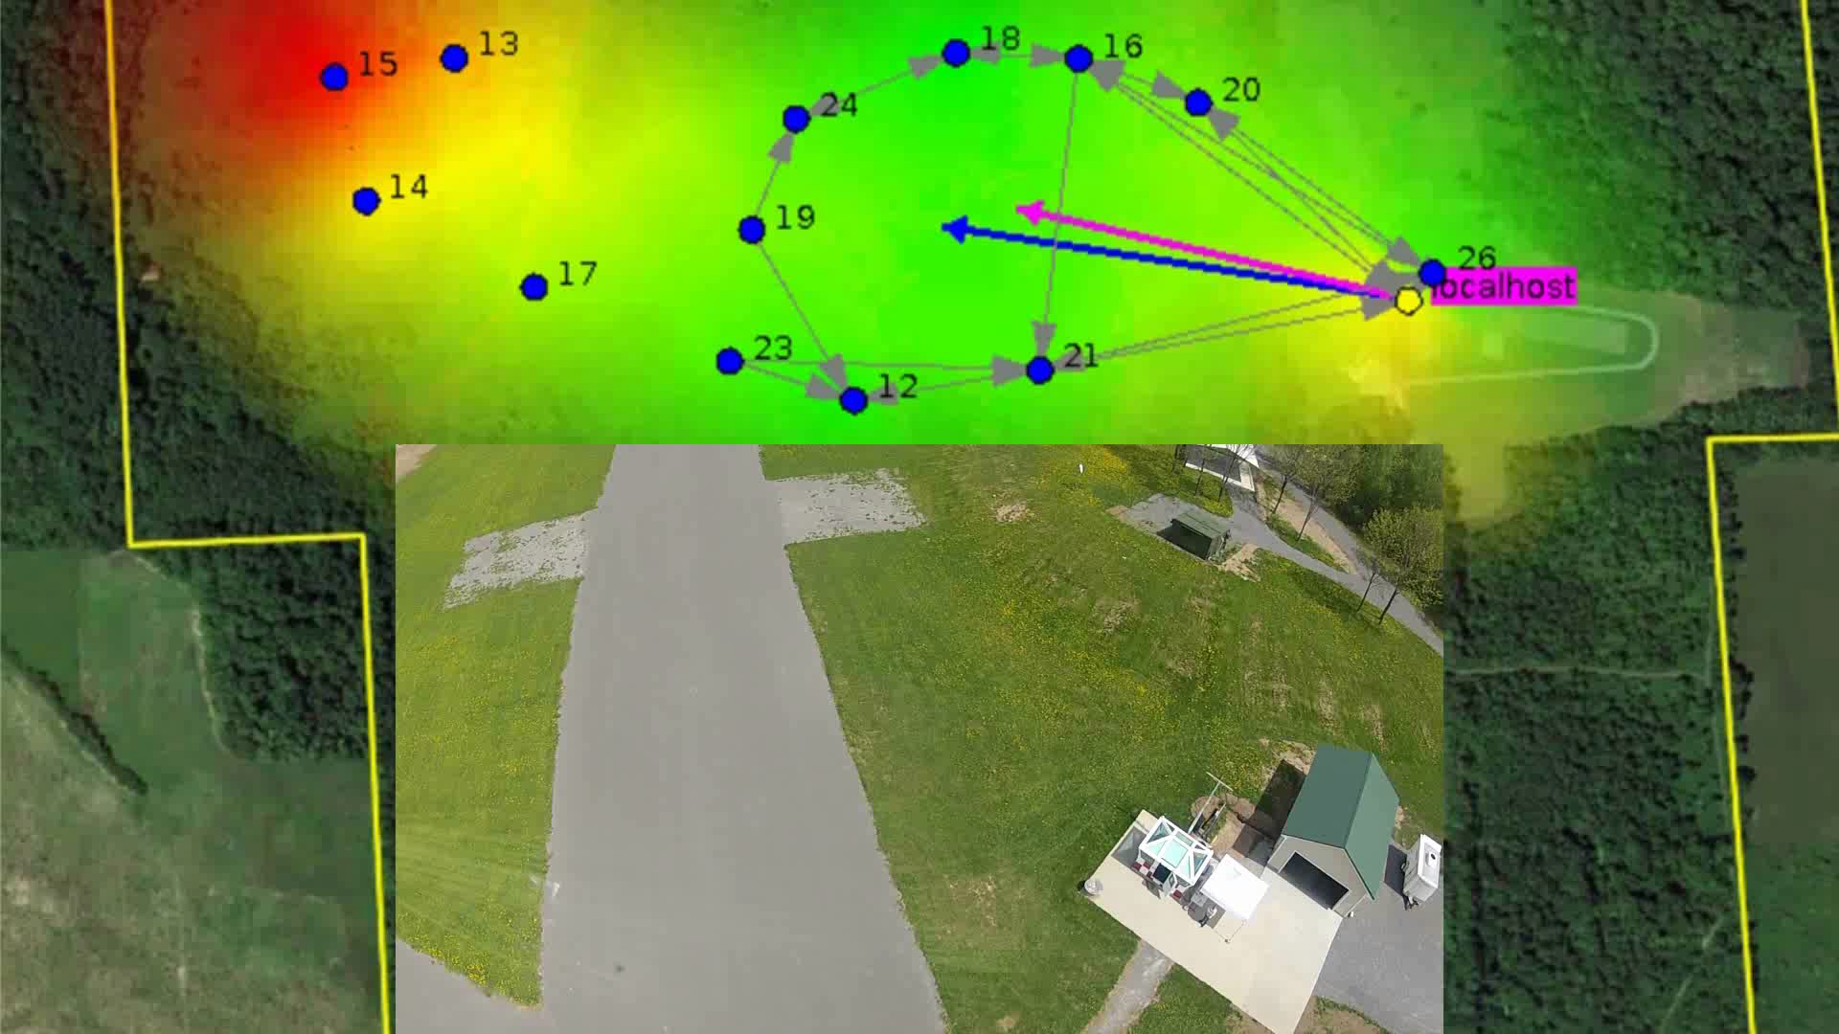
Self-Healing Communications - OPAL

Slide 39

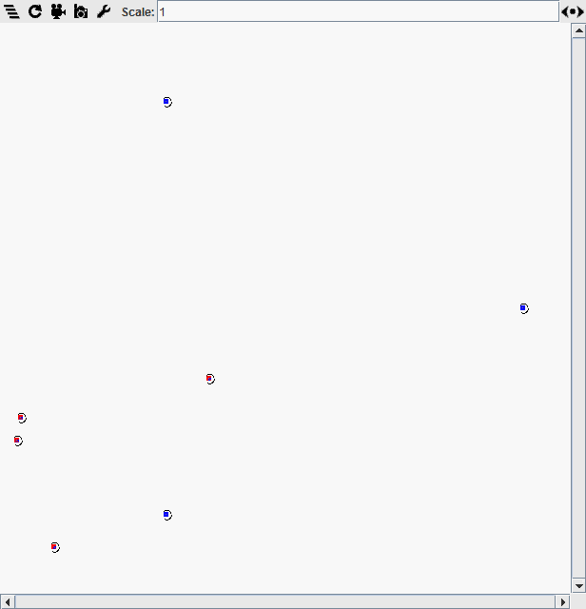
Data Ferrying – Emergent Spacing of Ferries
Stigmergy based approach to ferry spacing
  Pheromone level set by ferries
  Pheromone decays
  Subsequent ferry sets speed based on residual pheromone level
  Reset pheromone

Slide 40

Evolution of Swarm Behaviours
Distributed swarm control is a potential game changer.
How do we generate, evolve and select swarm behaviours
  Individual swarm members make local decisions which facilitate the global goal
Collaborations
  Monash

Slide 41
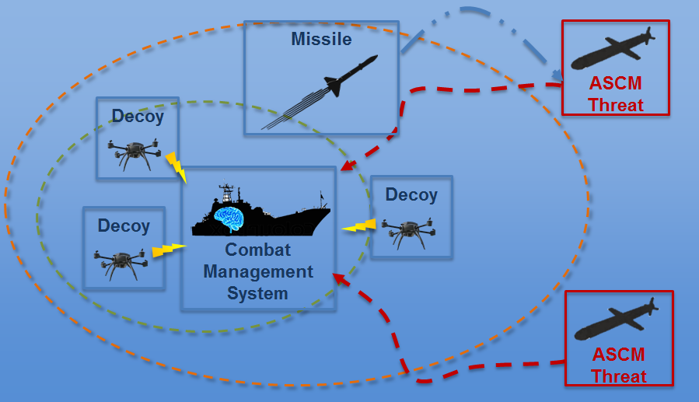
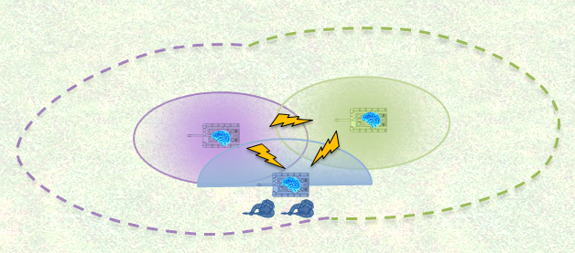
Coordinated Delivery of Effects
Autonomous Asset Defence
  Maritime assets protected through countermeasure deployment
  Land vehicle configure threat response dependent on their environment
Collaborations
  Uni of Melbourne
  Uni SA

Slide 42
Relevant Fields of Research
Distributed optimisation/ decision making/ control
Swarming and swarm robotics
Emergence
Mobile Ad-hoc Networks
Machine learning
Decision Making and Reasoning
Meta and Hyper Heuristic frameworks for swarming
All under the challenge of operating in a contested environment

Slide 43
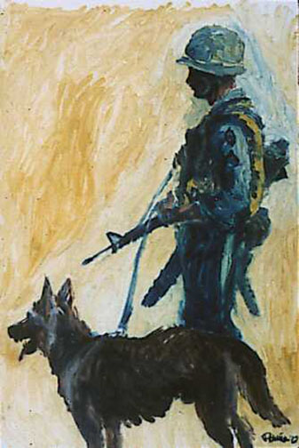
Notes:
SCOUT DOG by Augustine G. Acuna
Complimentary system: the question isn’t what makes it autonomous, but what makes it useful.
The dog brings new sensor modalities to the human operator, with high acuity and coupled and synthesised in ways that allow dogs to ‘make sense’ of what they see, hear, smell and feel.
The dog brings an alternate morphology, stable across varied terrain, energy efficient, faster and stronger, and smaller/better proportioned
The dog has encoded behaviours that allow it to function, including reflexes to specific types of stimuli, hunting and tracking instincts, self-preservation, loyalty
The dog brings encoded cognition—it recognises children, adults, cats, food, doors, bushes, whistles, whispers, etc in appopriate ways
The dog can have further behaviours encoded in complex ways through training and experience
The human brings intent, and cognitive flexibility on longer time scales, providing guidance and structure to the dog’s mission and role within the team. The human also helps the dog to learn, and to make decisions in the moment.

Slide 44
Useful autonomous systems…embodied in the real world.
Work under a range of environmental conditions
  Flexible and novel sensing modalities
  Flexible effecting modalities
  Flexible and robust motility
Work with the right balance of reactive and deliberate behaviours
  Reflexes
  Fast and Slow Reasoning
Work under direction, but without continuous control and with behavioural bounds
Work for longer periods under higher risk
  Size, weight, power

Slide 45






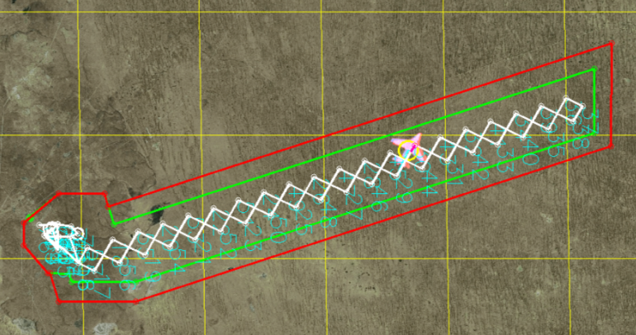
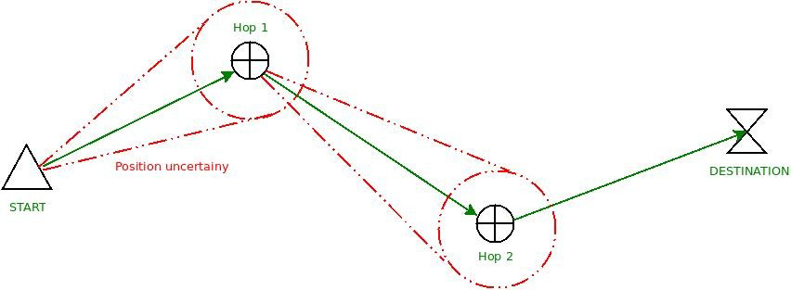

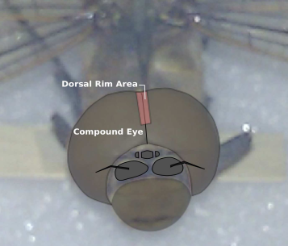
Persistent navigation in sparse, denied environments
Current Project Closed-loop alternate
navigation over long distances
Technical Work Multi-modal bio-inspired sensor synthesis, low power and light weight, feature extraction/matching, optical flow correction, sun polarisation
Future Motion/course coupling (move to sense), over-water, night-time, extending adoption of approaches from biological systems

Slide 46






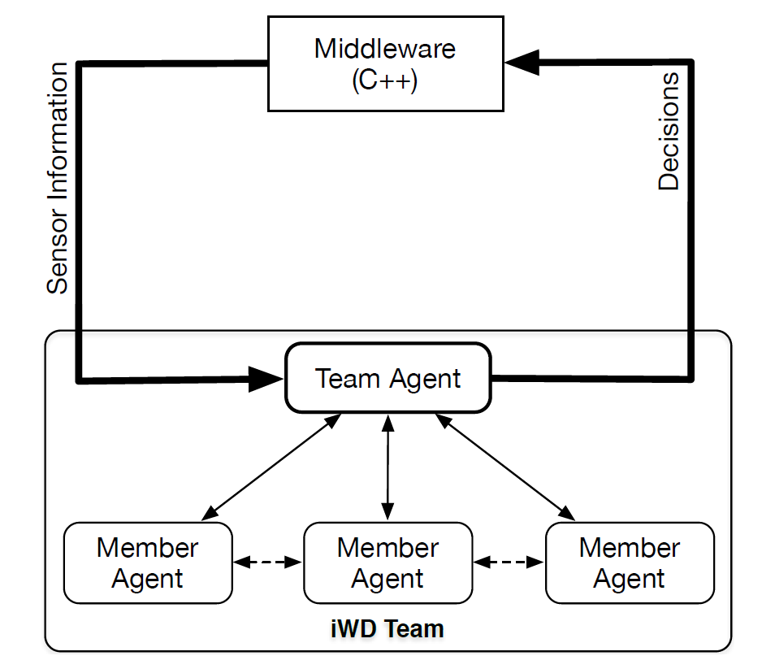

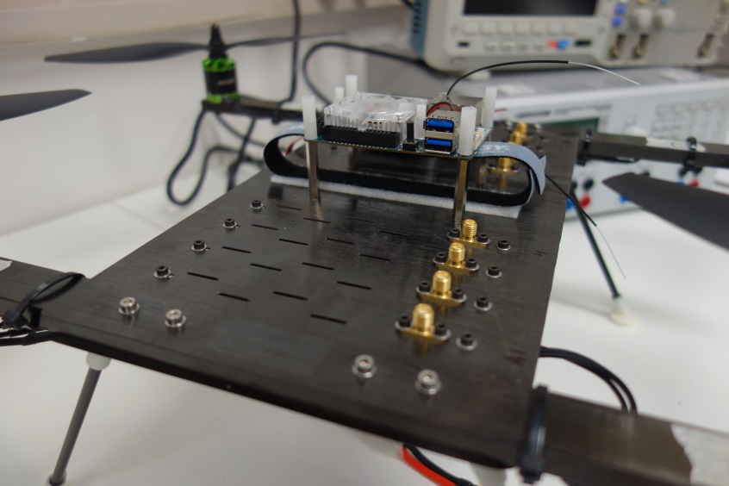
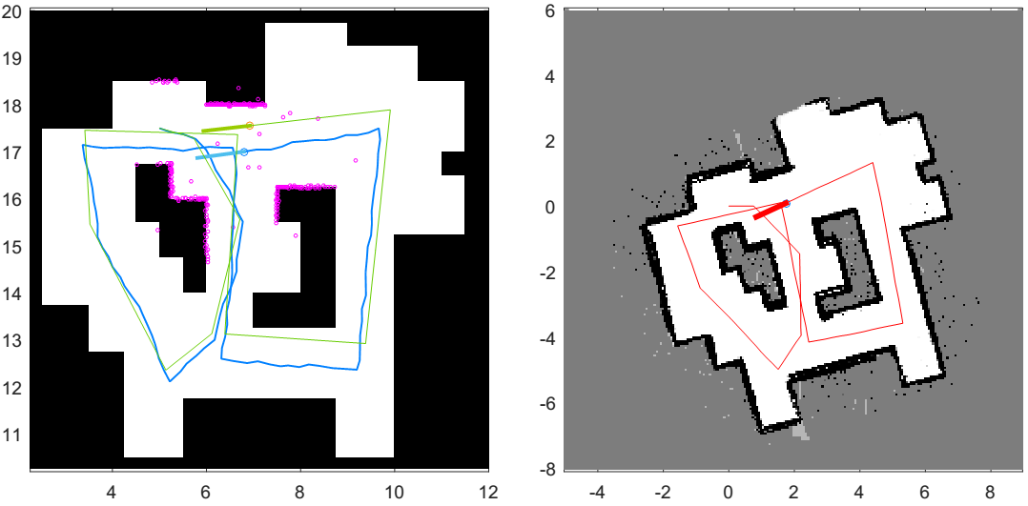
Operations in the Urban Canyon and Indoors
Current Project Autonomous teaming for exploring and characterising complex urban environments
Technical Work Novel light-weight sensors (event-based sensing, night vision, chemical sensing), multi-agent cooperative teaming, multi-functional structures
Future Extending sensor modalities, identifying and tracking individuals in complex environments

Slide 47





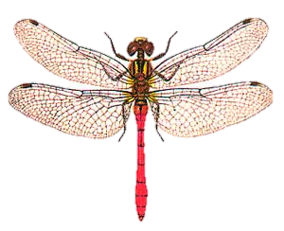
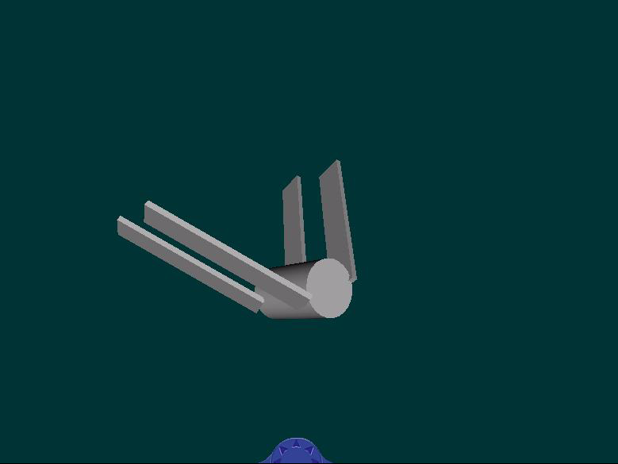
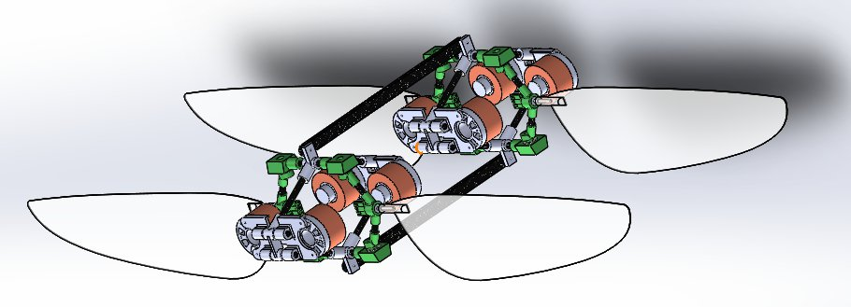
Novel and Adaptive Motility and Effectors
Current Project Build a four-wing platform capable of sustained hover, glide and flapping
Technical Work Evolutionary morphology applied to four-wing platform, ‘real time’ machine-learned flight behaviour, extending CFD and flight-dynamics models to non-linear
Future Soft-robotics, embedded light-weight energy/power and controllers, embedded sensing, novel motility solutions for difficult environments (not just flying)

Slide 48
Summary
Research expertise to develop
sensor modalities and approaches to modality synthesis for richer and more persistent cognition
platform morphologies to enhance motility, reduce ‘observability’, increase resilience
effector solutions to enrich possible range of intentionality
platform behaviours to enhance self-regulation, cooperative sensing and effecting
Notes:
DST brings considerable knowledge and expertise in trialling systems, and also has access to world class facilities for testing and characterising unmanned vehicles indoors and outdoors.

Slide 49
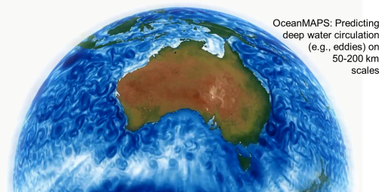
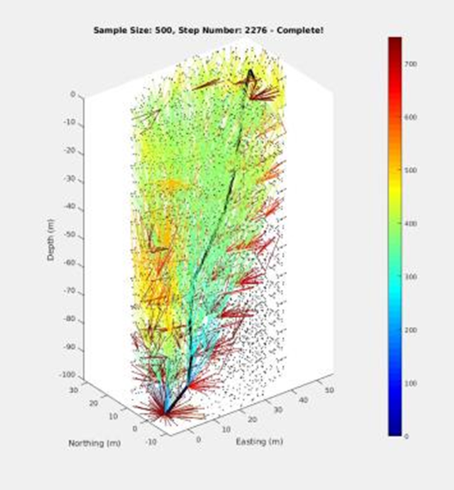
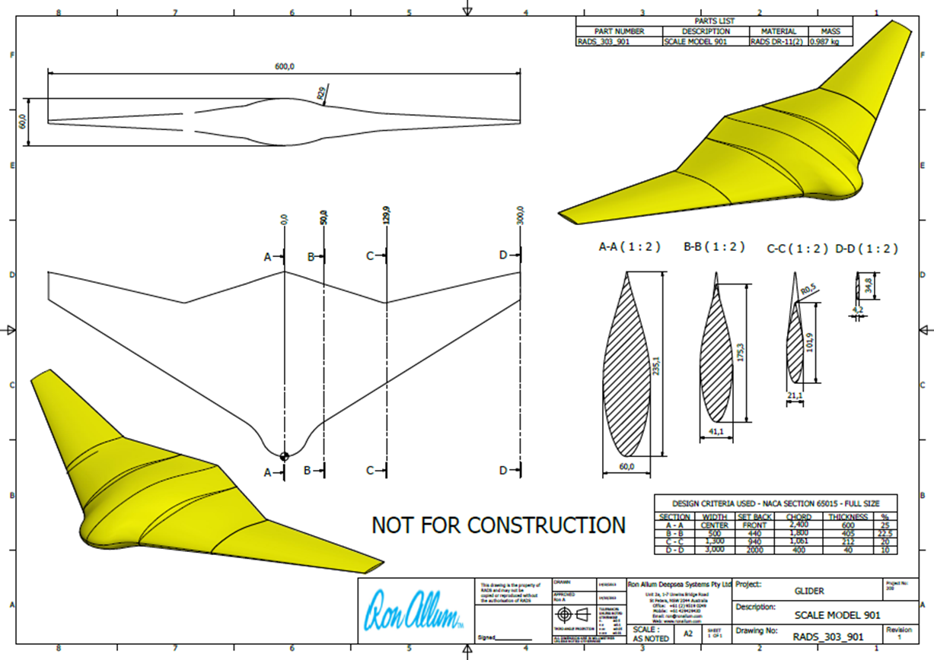
Deep Ray – Undersea Glider
Background: Solutions for long-endurance autonomous ocean surveillance are required. Leverage the $50B investment in manned submarines.
Goal: Implement Deep Ray resilience with GPS and communications independence.
Research Agreements: ACFR Uni Sydney (probabilistic version of FMT path planner)
Industry: Ron Allum Deepsea Services (design &
construction)
POC: Dr David Battle
Fast Marching Trees
path planning

Slide 50



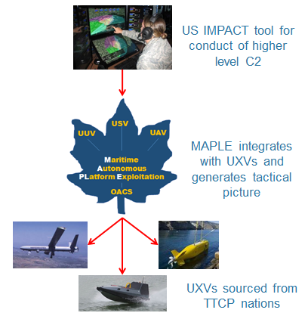
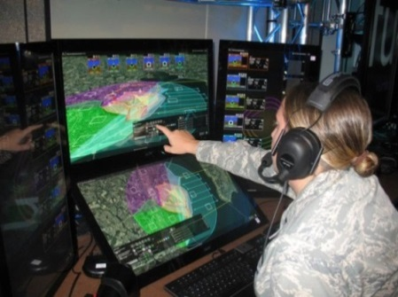




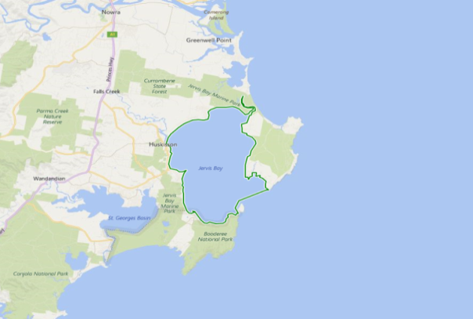
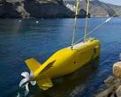
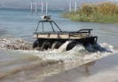











Our mission is to enhance, demonstrate and evaluate the military utility of autonomous systems for future littoral operations.
Autonomy Strategic Challenge
Outcomes
Autonomy Interoperability gives FVEYS military a surprise advantage over adversaries with novel system and platform combinations
Demonstrate that a single operator is capable of managing multiple autonomous vehicles operating simultaneously in air, land, sea surface and undersea domains.
Acceleration into service game changing FVEYS technologies that support offset operations.
Supported by MAR, HUM, C3I, AER and JSA Groups and harnesses new talent in machine learning.
Objectives
  Determine the potential military utility of autonomy technologies.
  Advance and demonstrate human-autonomy teaming through simulation and live trials.
  Improve interoperability of emerging FVEYS autonomous systems.
  Engage and spur industry development for FVEYS military requirements.
C2 Autonomy Technologies
Effective & flexible human management of multiple simultaneous UV missions (IMPACT).
Policy management (COMPACT).
Machine recommends multiple action ‘plays’ learned via online operator feedback.
UV-Combat System integration (MAPLE)
Trials
2016 Unmanned Warrior (UK)
2017 Integration Trials (US,UK,CA,NZ)
2018 Autonomous Warrior (AS)
Platform Autonomy Technologies
Littoral Force Protection
Base Protection
Autonomy to reduce deployed operators, control more UxVs, shorten response times
Unmanned Vehicle team coordination software (iWD)
Unmanned Vehicle Mission Oriented Operating Suite (MOOS) integration
TTCP Autonomous Warrior
September 2018
Jervis Bay, Australia
Base Protection
Air, Land,
Sea surface
Underwater
Scenarios
Critical Infrastructure Protection
Air, Sea surface and Underwater
Counter-smuggling
Air, Sea surface and Underwater
Multi-role Aviation Training Vessel (MATV) slated for UxV launch, command and control, recovery in Autonomous Warrior trial.
Littoral Interdiction
Counter-smuggling
Autonomy to enable a new capability to address underwater threats
Littoral Underwater Area Denial
Critical Infrastructure Protection
Autonomy to lower exposure of military personnel to risks & less resource intensive.
Smuggler mini sub
Notes:
A key part of the Capability Demonstrator Program to end of 2018…
Five-eyes community.
Integrated and loose-coupled technologies.
Opportunity to field-demonstrate new technologies Jervis Bay September 2018

Slide 51
Agenda
0930 Reception
1000 Background, Motivation, Aims, Overview – Jason Scholz
1030 Defence Requirements – ADF representative
1100 Current Research Projects – Theme Leaders
1200 Working Lunch
1230 Open Q&A / Discussion
1330 RFI and Next Steps
1400 Close

Slide 52
Agenda
0930 Reception
1000 Background, Motivation, Aims, Overview – Jason Scholz
1030 Defence Requirements – ADF representative
1100 Current Research Projects – Theme Leaders
1200 Working Lunch
1230 Open Q&A / Discussion
1330 RFI and Next Steps
1400 Close

Slide 53
Agenda
0930 Reception
1000 Background, Motivation, Aims, Overview – Jason Scholz
1030 Defence Requirements – ADF representative
1100 Current Research Projects – Theme Leaders
1200 Working Lunch
1230 Open Q&A / Discussion
1330 RFI and Next Steps
1400 Close

Slide 54
RFI Format
Request for Information
~ 2 pages per proposal
Email to: tascrc@dsto.defence.gov.au
Proposal Title
Lead POC details
Relationship to CRC Objectives, Defence requirement and/or existing project
The proposal and expected impact
Brief outline of key researchers. Including availability (FTE), experience and track record relevant to the proposal

Slide 55
Thank You!

