Slide 1
Human Performance Projects
Project Description
Project: Team Performance and Coordination
Main issues
Partners
Defence Science and Technology Group (DSTG)
Office of Naval Research (ONR)
Purpose
Investigate how teams of military personnel perform complex team tasks through cooperative team behaviours
Product
Enable the measurement of team performance in cooperative tasks e.g. to supplement After Action Reviews
Notes:
Applying methods that have been used more commonly in analysis of elite sports performance
Brief description of IET section attack assessments i.e. 12 participants on patrol suddenly engaged by enemy force. Need to form extended line and advance to neutralise threat.
Product: To understand how we can measure the behaviours observed during the attack. To objectively assess the team rather than the individuals. To ultimately inform development of training activities.
Brief overview of the process attaching GPS units and then mapping the position of each participant and calculating spacings and synchrony of movements throughout training activities.

Slide 2
Human Performance Projects
Path to Impact
Project: Team Performance and Coordination
Main issues
What we have learnt so far?
Section attack performance can be viewed as spatial metrics from GPS data i.e. length, width, synchrony, dispersion, surface area
Differences in spatial GPS metrics can be seen between different sections
Section attacks are highly variable i.e. the same scenario can be approached in many different ways. Yet, underlying behaviours may remain consistent or influenced by expertise (current project)
What does that mean for ADF capabilities?
Team behaviour could be measured in a variety of contexts, which prevents inferring team performance from individual performance
Potential tool providing objective analysis of attacks during after action reviews (AARs)
Objectively measuring cooperative behaviour of military teams is one step closer to designing effective training interventions
Notes:
Additional points to include if needed:
End users have indicated strong interest in objective AAR analysis.
IET section attacks are generally not given a clear performance rating. Generally just subjective feedback (many different scenarios and assessors are used who need to interpret the performance). Generally pass unless fratricides.
Will enable investigation into how various constraints may affect the behaviour of a team e.g. effect of dense bush vs open areas, experts vs novices, different team compositions, changes in load carriage or munitions, weather conditions, availability of communication devices and other technologies etc.

Slide 3
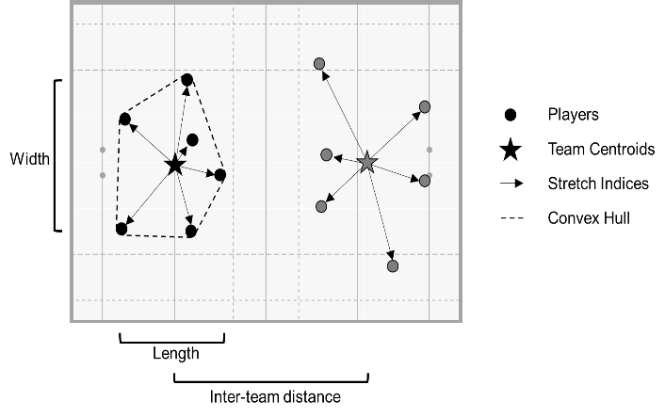
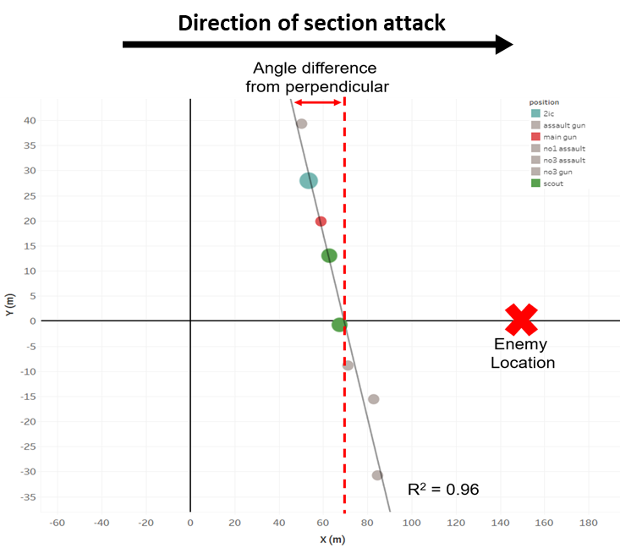
Human Performance Projects
The Science
Project: Team Resilience
Main issues
Determine the validity of team coordination measures during IET section attacks as part of planned training activities
Determine the effects of expertise on section attack behaviours (comparing IET with Duke of Gloucester Cup participants)
Assess the effect of human-machine teaming activities on cooperative behaviour
Discussions with SMEs occurring on rolling basis pre/during/post IET section attacks
Notes:
Currently collecting data with SOI to determine if there are common behaviours between different sections when performing attacks.
Additional data collection e.g. with DoG cup will help to determine if expert sections behave differently to IET.
Following this, we will investigate whether advanced information provided by various technologies affects team behaviours and ultimately performance outcomes.
Discussions with SMEs are ongoing and occur as part of each data collection.

