Slide 1
Human Performance Projects
Project Description
Project: Microbiome
Main issues
Partners
DSTG: Dr Katie Tooley and Mr Brad Baker
Purpose
To use a multi-biological systems approach to characterise the cumulative and combined effects of the multi-stressor 1RTB training military environment on microbiota composition, diversity and associated metabolites in Australian army recruits
Product
Projecting Risk: Create a statistical model that will be used as a predictor tool for the future identification of recruits ‘at risk’ of dysbiotic changes in the gut and negative impacts on aspects of cognition.
Notes:
So weve asked our uni leads to send through the issues theyre currently experiencing and what solutions they may be using to overcome their issues.
Noted issues are:
Any issues you are facing that isn’t covered here? Or any observations
Are there any risks/issues to the stakeholders that were missing? IE reputational risk. Minimising access to troops to reduce risk of further COVID outbreaks??
Short of postponing the project which risks losing PHDs and key researchers resulting in further delays in re-hiring, we need to look for new sustainable solutions.

Slide 2
Human Performance Projects
Path to Impact
Project: Microbiome
Main issues
What we have learnt so far?
Preliminary analysis from approx. 60 recruits undergoing Basic Army Training
Significant changes in dietary intake, self-reported stress and sleep quality markers, cognitive performance (i.e. executive function, spatial planning) and microbiota diversity and composition over the 11 weeks.
Significant associations between alpha- and beta-diversity and microbial species and several cognitive subdomains of executive function (multi-tasking).
What does that mean for ADF capabilities?
Preliminary findings suggest significant shifts in microbiota composition following military stressors
Microbiota diversity and specific species appear to be associated with aspects of cognition, especially executive function
Lead to evidence-based data for the future development of microbiota targeting interventions as novel, low-cost strategies for preserving the ‘pre-stressed’ microbiota and optimizing warfighter’s cognition (or aspects of) and well-being.
Notes:
So weve asked our uni leads to send through the issues theyre currently experiencing and what solutions they may be using to overcome their issues.
Noted issues are:
Any issues you are facing that isn’t covered here? Or any observations
Are there any risks/issues to the stakeholders that were missing? IE reputational risk. Minimising access to troops to reduce risk of further COVID outbreaks??
Short of postponing the project which risks losing PHDs and key researchers resulting in further delays in re-hiring, we need to look for new sustainable solutions.

Slide 3
Human Performance Projects
The Science
Project: Microbiome
Main issues
Significant impact from COVID that has led to delays in recruiting.
Enrolled 189 recruits in 2021 and 2022
148 completed Week 5 testing
125 completed Week 11 testing
Findings:
Cognitive Performance Nutrition Self-reported Assessments
In Week 1:
Poorer Executive Function
Poorer Memory Function
Better Attention and Psychomotor Speed
In Week 1:
Lower dietary intakes (specifically carbohydrates) compared to MRDI
In Week 1:
Higher perceived stress and poor sleep quality
Notes:
So weve asked our uni leads to send through the issues theyre currently experiencing and what solutions they may be using to overcome their issues.
Noted issues are:
Any issues you are facing that isn’t covered here? Or any observations
Are there any risks/issues to the stakeholders that were missing? IE reputational risk. Minimising access to troops to reduce risk of further COVID outbreaks??
Short of postponing the project which risks losing PHDs and key researchers resulting in further delays in re-hiring, we need to look for new sustainable solutions.

Slide 4
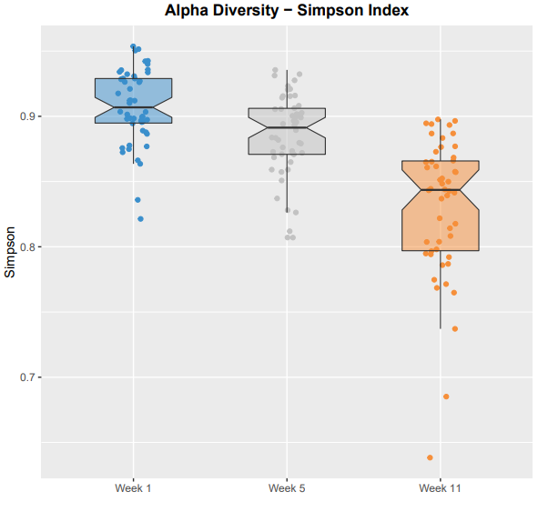
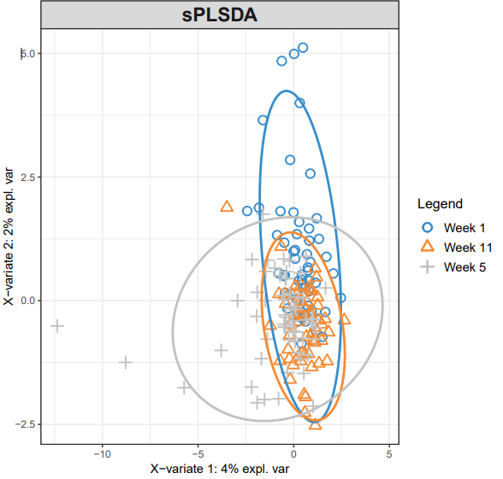
Human Performance Projects
The Science
Project: Microbiome
Main issues
Microbiota Findings:
Oral Microbiota
Gut Microbiota
Significant differentiation of beta diversity at the week 11 time point, with an enrichment of numerous Streptococcus species
A small number of species appear to have strong statistical associations with numerous cognitive subdomains of executive function
Alpha diversity
Beta diversity
Alpha diversity - significant decrease over time
Beta diversity- increase in similarity of microbial composition over time
Notes:
So weve asked our uni leads to send through the issues theyre currently experiencing and what solutions they may be using to overcome their issues.
Noted issues are:
Any issues you are facing that isn’t covered here? Or any observations
Are there any risks/issues to the stakeholders that were missing? IE reputational risk. Minimising access to troops to reduce risk of further COVID outbreaks??
Short of postponing the project which risks losing PHDs and key researchers resulting in further delays in re-hiring, we need to look for new sustainable solutions.

