Slide 1
Human Performance Projects
Project Description
Project: Autonomous System Transparency
Main issues
Partners
Defence Science and Technology Group
University of Queensland
Oregon State University
Purpose
Establish principles for designing transparent automated systems that operators can accurately and efficiently use in ADF operational settings.
Product
Publication in high quality international scholarly journals
Delivery of best-practice guidelines to the ADF for (a) designing for automation transparency in operational environments, and for (b) methods to test those designs in high fidelity simulations with expert ADF operators.
Notes:
So weve asked our uni leads to send through the issues theyre currently experiencing and what solutions they may be using to overcome their issues.
Noted issues are:
Any issues you are facing that isn’t covered here? Or any observations
Are there any risks/issues to the stakeholders that were missing? IE reputational risk. Minimising access to troops to reduce risk of further COVID outbreaks??
Short of postponing the project which risks losing PHDs and key researchers resulting in further delays in re-hiring, we need to look for new sustainable solutions.

Slide 2
Human Performance Projects
Path to Impact
Project: Autonomous System Transparency
Main issues
What we have learnt so far?
Higher automation transparency mitigated the negative impacts of low automation reliability, and of concurrent task demands, on the accuracy of automation use.
Higher automation transparency reduced perceived workload, decreased decision time, and increased the perceived usability of automation.
No impact on trust in automation, or on confidence in decisions.
What does that mean for ADF capabilities?
Increasing the transparency of automation has the potential to allow operators to more accurately and efficiently use automation by facilitating the understanding of the reasoning underlying advice.
Automation transparency can mitigate the impact of well-known factors that decrease the accuracy of automation use.
Notes:
So weve asked our uni leads to send through the issues theyre currently experiencing and what solutions they may be using to overcome their issues.
Noted issues are:
Any issues you are facing that isn’t covered here? Or any observations
Are there any risks/issues to the stakeholders that were missing? IE reputational risk. Minimising access to troops to reduce risk of further COVID outbreaks??
Short of postponing the project which risks losing PHDs and key researchers resulting in further delays in re-hiring, we need to look for new sustainable solutions.

Slide 3
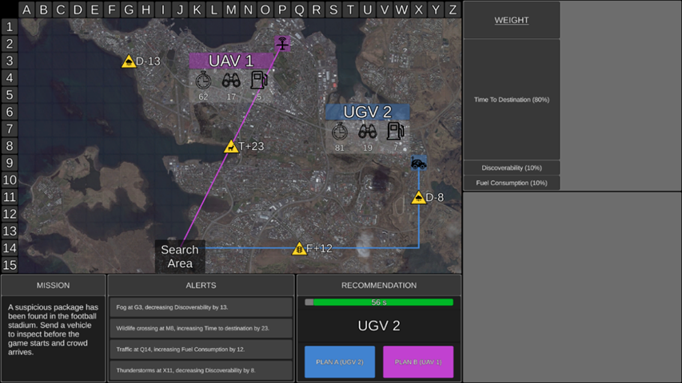
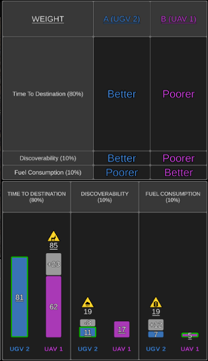
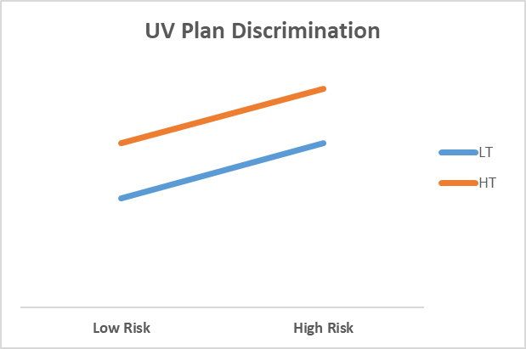
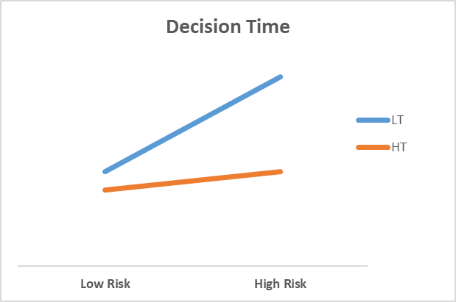
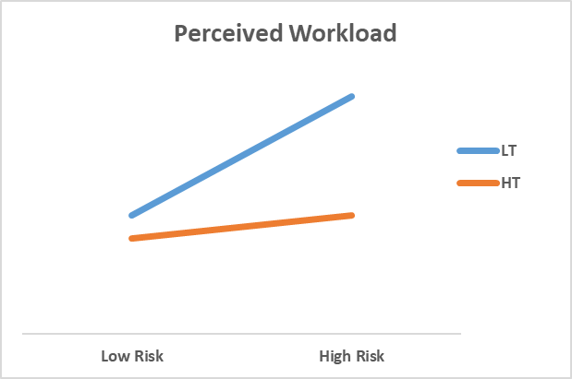
Human Performance Projects
The Science
Project: Autonomous System Transparency
Main issues
Can human effectively decide to use different levels of transparency (adaptive transparency)
Objective mission risk
Perceived mission difficulty
Experimental Conditions
Low transparency
High transparency
Adaptive transparency
Notes:
So weve asked our uni leads to send through the issues theyre currently experiencing and what solutions they may be using to overcome their issues.
Noted issues are:
Any issues you are facing that isn’t covered here? Or any observations
Are there any risks/issues to the stakeholders that were missing? IE reputational risk. Minimising access to troops to reduce risk of further COVID outbreaks??
Short of postponing the project which risks losing PHDs and key researchers resulting in further delays in re-hiring, we need to look for new sustainable solutions.

