Slide 1

Human Performance Projects
Project Description
Project: A personalised digital sleep and circadian management tool for human performance
Partners
Curve Tomorrow (Senevirathne, Charalambous, Quan)
Monash University (Sletten, Rajaratnam, Varma, Howard, McLachlan)
Defence Science and Technology Group (Aidman)
Purpose
To develop an innovative, evidence-based digital technology that delivers personalised sleep and circadian intervention strategies to
enhance recovery
optimise performance in Defence personnel.
Product
A proof-of-concept mobile app providing evidence-based sleep and performance management tailored for the Australian Defence Force
Notes:
Next Generation Technologies Fund
Optimise performance and resilience
Curve Tomorrow: a health technology company
Support from Human Factors specialist Mark Corbett
In addition to working under conditions of high stress, and high cognitive and physical demand, Defence personnel often work shift work and extended deployments
Circadian disruption, poor sleep quality, sleep deprivation
Fatigue, impaired vigilance and higher order cognition – impact deployment readiness and on-duty effectiveness
Also need to consider variability in duty hours due to operational needs and individual differences in response to SW
Need = personalised, practical, scaleable tool to optimise sleep, circadian adaptation and recovery

Slide 2
Human Performance Projects
Path to Impact
Project: A personalised digital sleep and circadian management tool for human performance
What we have learnt so far?
Air traffic controllers want a multi-modal, personalised tool that targets sleep to improve performance and assists with lifestyle management, including:
Personalised recommendations based on rosters
Notifications and cues to prompt behaviour
Sleep education toolkit element
Easy to use interface and integration with calendar
What does that mean for ADF capabilities?
Development of an evidence-based automated practical strategy to support sleep, circadian adaptation and recovery.
Enhanced human performance, cognitive fitness, and fatigue resilience.
Notes:
Have prototype (with healthcare) – enter duty schedules, commitments, habits.
Algorithms based on sleep and circadian principles form our prior work - personalised sleep-wake recommendations.
Two weeks of prototype testing in shift workers demonstrated:
- More TST, reduced SOL and insomnia severity
70% improved satisfaction with ability to fall asleep
high levels of user engagement with the app and two thirds (67%) of users reported that the app influenced their behaviour.
majority of users reported improvements in their satisfaction with their ability to fall asleep (70%),
with their quality of sleep (81%), and in their recovery during non-work periods (52%), compared to baseline.
The majority of individuals also recorded improvements in scores on scales of depression (80%), anxiety (70%) and stress (70%).

Slide 3
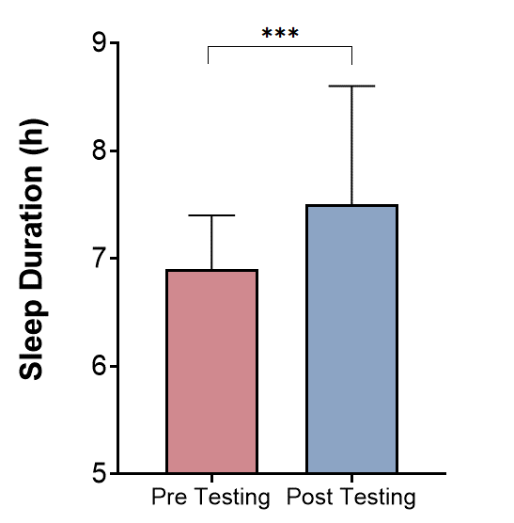
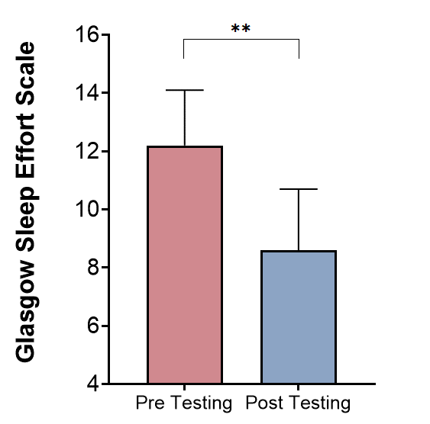
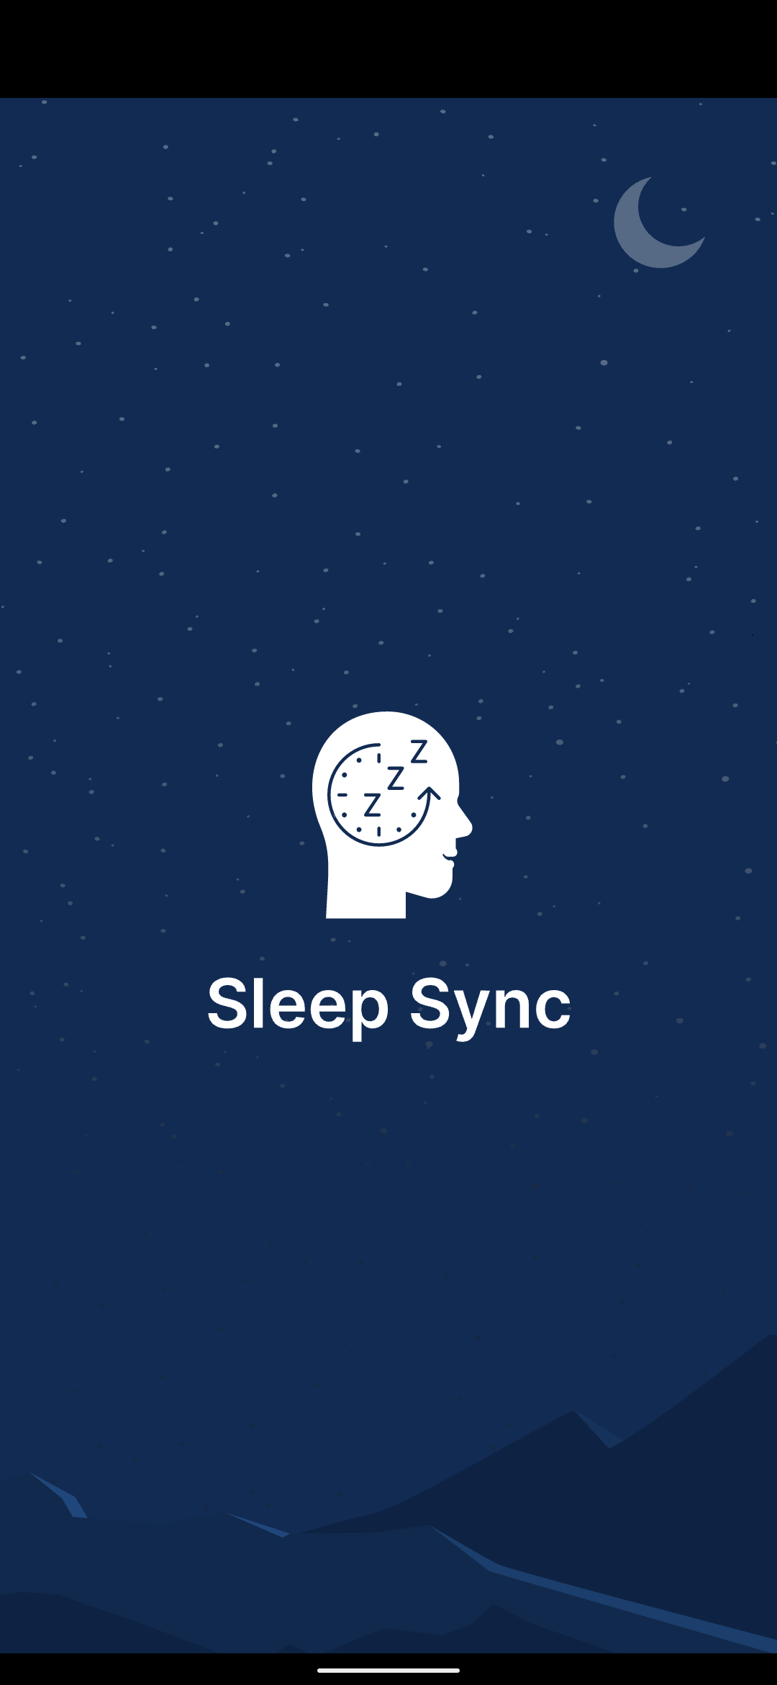
Human Performance Projects
The Science
Project: A personalised digital sleep and circadian management tool for human performance
“I found the sleep times very useful (as long as they matched up to what I was doing the next day), and the general sleep hygiene recommendations were good.”
“The phone/screen recommendations were good, as was the caffeine intake suggestions.”

