Slide 1
Human Performance Projects
Project Description
Project: Autonomous Team Tasking
Main issues
Partners
20th Regiment Royal Australian Artillery
Major Russell Hamsey
DSTG
Dr Dawei (Vicki) Jia
UNSW
Prof Mari Velonaki, A/Prof David Rye, Dr Ethan Jones, Dr Sarita Herse, Jorge Forseck Rauh Hain, Dr Teresa Crea, A/Prof Nadine Marcus, and Prof Katsumi Watanabe

Slide 2
Human Performance Projects
Project Description
Project: Autonomous Team Tasking
Main issues
Purpose
Develop a non-intrusive multisensory system that can estimate the cognitive workload of UAV operators, and an AI-based autonomous advisory system (AAS) to predict and improve team performance.
Product
Finalise a working AAS prototype that can be used for future implementation within an operational ground control station (GCS) environment.

Slide 3
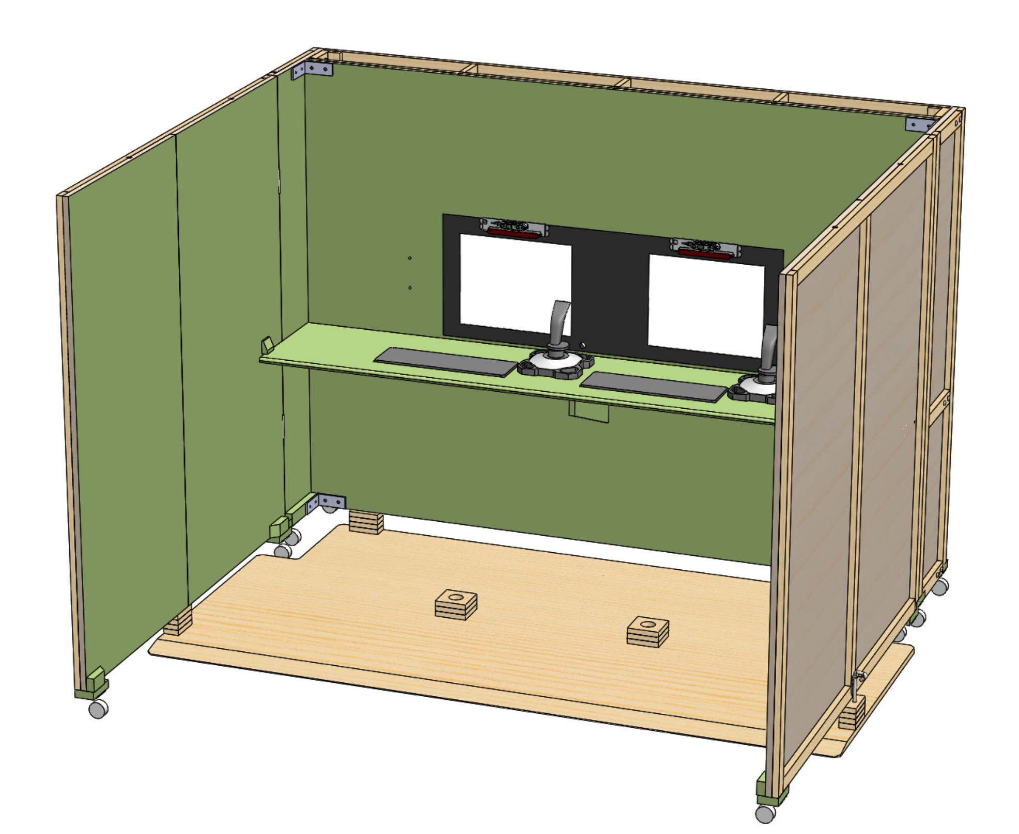
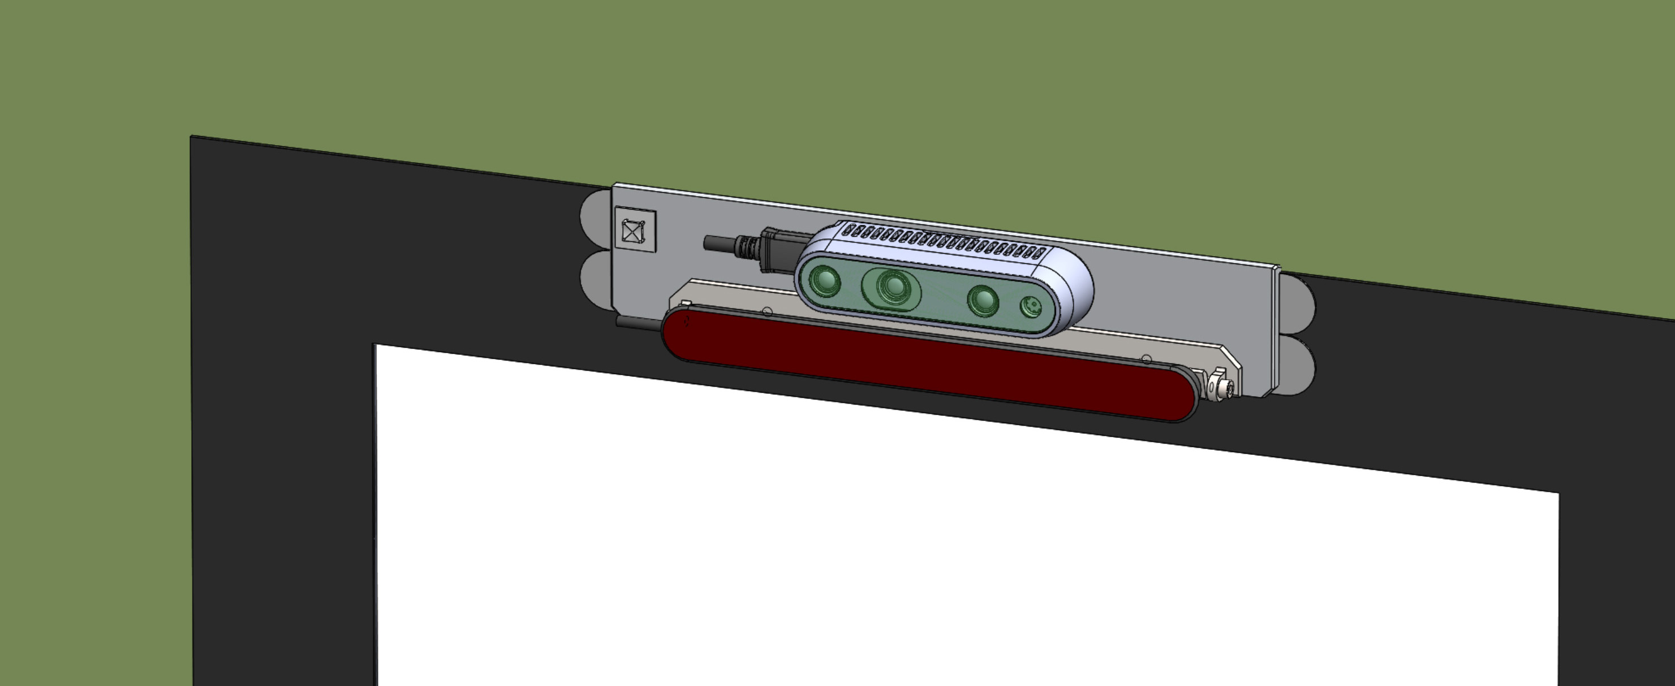
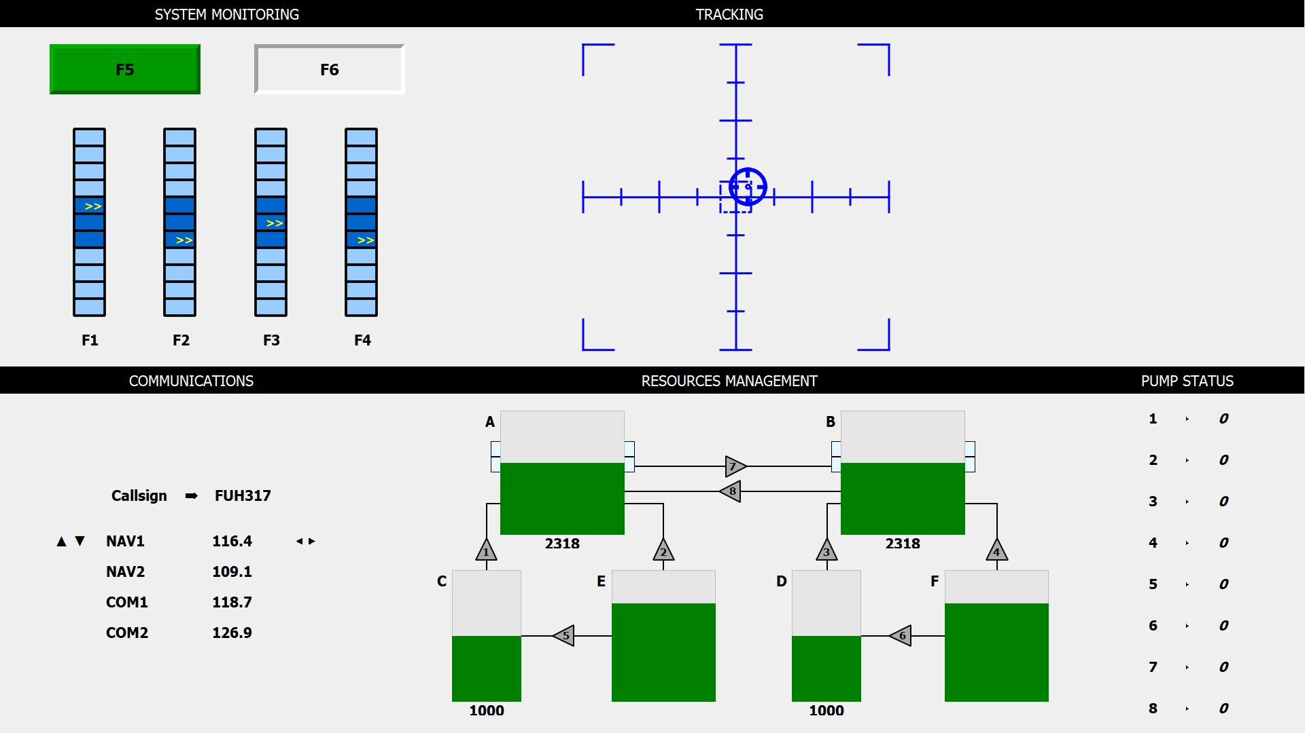
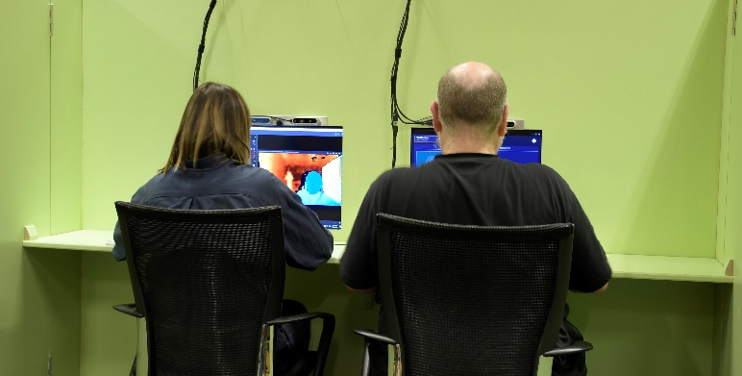
Human Performance Projects
Simulation and Testing
Project: Autonomous Team Tasking
Main issues
Notes:
Experimentation
Completion of 1:1 simulated GCS environment
Sensor setup [need info here]
Enhancement of load task built from OpenMATB
Controlled augmentation of cognitive workload: Load task, testing environment
Commencement of data collection

Slide 4
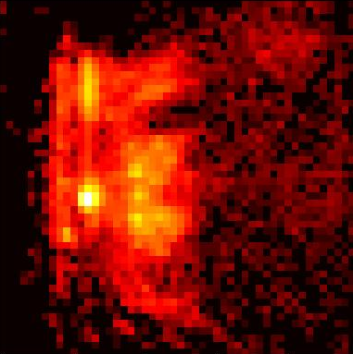
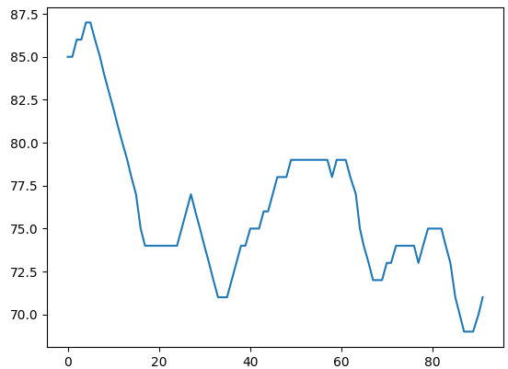
Human Performance Projects
ML Analysis
Project: Autonomous Team Tasking
Main issues
Predictions:
Cognitive Load
Fatigue
Performance
Image Features
Gaze Analysis
Unintrusive Sensors
Audio Features
Heart Rate

Slide 5
Human Performance Projects
Path to Impact
Project: Autonomous Team Tasking
Main issues
ADF capabilities
Design of novel, nonintrusive AAS interface for UAV operators
Contribution to improve fidelity simulation training environments
Packaged research tools, applicable to other high-load remote monitoring and control environments
Implementation: GCS environment
Mapping of communication flow and chain of command
Modelling of GCS training and operational environment
Finalised documentation of operation context and working conditions of the Shadow 200 aircraft and payload operators
Mature designs for implementation, testing, and assessment

